Slide 1
Weekly Net Control
Review of Net Control tasks and resources for
Monday night Net.
by Madeline Lombaerde, KD6JTU
Notes:
This training session will cover how to be Net Control for the weekly Monday night net..
Many elements transfer directly into being Net Control for an emergency as well.
This session covers where to find the resources you’ll need to run net and proper procedures for the weekly net.
We’ll be covering how to use the roll call log to record the check-ins and send it as the permanent record for the Net.

Slide 2
Why is there a Weekly Net?
Test equipment: yours, agency
Training for a directed net
Training for using radio and linked repeater
to send/receive messages
Training for using an agency’s form
Latest information about events/exercises
Get to know members’ voices over radio
Notes:
Why do we have a weekly net?
We are COMMUNICATORS! The weekly net is for practice/training and testing our radios and antennas.
Practice for participating in a directed net
Practice using a repeater and linked remote base
Practice using a form that’s not our own: like an agency’s form in an activation.
Get the latest information about coming events and exercises; chance to volunteer
Will get to know members’ voices ... helps when signals are weak

Slide 3
Net Control Preparation
Net Procedure
Roll Call
  in call sign order
  in city order
Call sign of Net Control for next week
Paper/pencils/pens
Assistant (optional)
Directions/access codes to EOC
Practice, Practice, Practice
Notes:
Before the day of your net control assignment,
Get a copy of the net procedure and REHEARSE IT. Don’t try to wing it! Listeners can tell when you have not prepared. Suggestion: use this copy to follow net when others are Net Control. How do you get the net procedure? Instructions follow …
Fill in the italicized words with information you know beforehand. Finish it just before net starts.
Get the Roll Call either in call sign order or city order. If this is your first time, use call sign order. City order is for experienced operators. How do you get the Roll Call in call sign order? Download from web site or get it from the Rosters list or Dropbox.
Get the call sign and first name of the member assigned as Net Control for the week following your assignment. How do you get it? Best way: use Roster list folder or WeeklyNet folder in Dropbox. Alternative: send an email to netcontrol –at- k6mpn.org ... this will always be the latest list. Last resort: look in the latest newsletter.
Bring extra paper and pencils/pens
It’s optional to have an assistant, but it is nice to have one; it’s essential if you’re new to being Net Control
Whenever possible, run the net from an EOC installation, NOT FROM HOME. We’re testing the installation equipment at the EOCs to identify potential problems BEFORE an emergency activation
Redwood City: requires access code for parking lot and building entrance. What is it?
Belmont: use PD entrance on far right side of City Hall entrance. Ask at window for the key to get into the EOC (2nd floor)
San Carlos: more difficult to get in. Must make arrangements well in advance.
Menlo Park/Atherton
Again, practice going over the net procedure.

Slide 4
Net Control Resources
Where can I find the Roll Call and Net Procedure, Net Control for next week?
  Download directly from k6mpn.org web site
  In the Rosters folder
  Dropbox WeeklyNet folder
  under SCARES-Members folder
  ➔Net Control for next week only
    Email netcontrol –at- k6mpn.org
    Last resort: latest newsletter
Notes:
Net Control Resources or Where Can I Find the Roll Call and Net Procedure
Members can find the roll call and net procedure in several places
Download from k6mpn.org web site
In the rosters folder
In the Dropbox folder SCARES-Members > WeeklyNet
The last point is only for getting the Net Control for next week if you don’t get it elsewhere

Slide 5
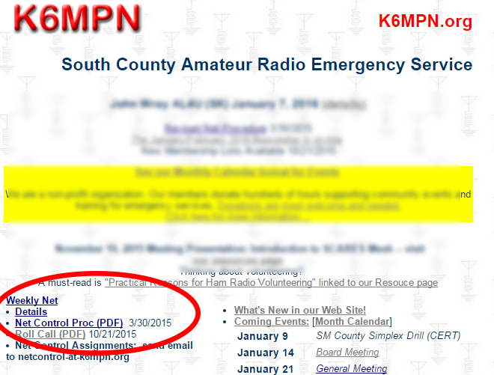
Download from k6mpn.org
Notes:
The fastest, easiest way is to download the files directly from the k6mpn.org home page

Slide 6
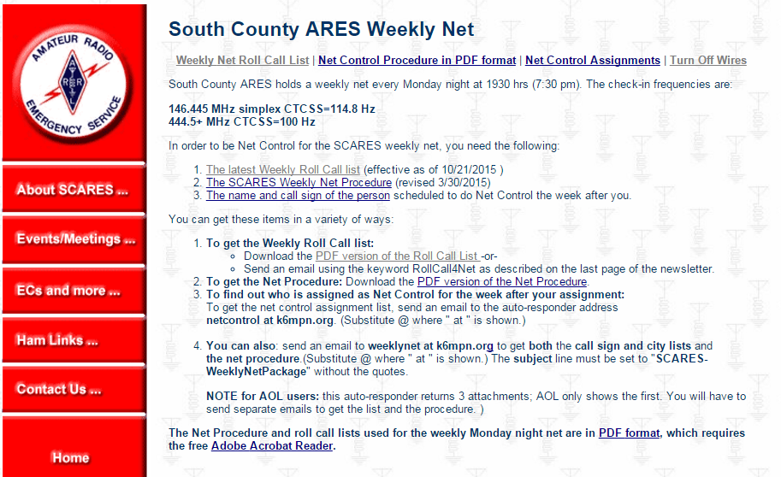
Weekly Net Page: k6mpn.org
Notes:
You can download the roll call by call sign list and the Net Procedure directly from the k6mpn.org home page or this page.
To get the name and call sign of the person doing NC next week, you can send an email to netcontrol –at- k6mpn.org.
It’s faster to get the list from the Dropbox folder or Rosters list. Directions for those two methods follow.

Slide 7
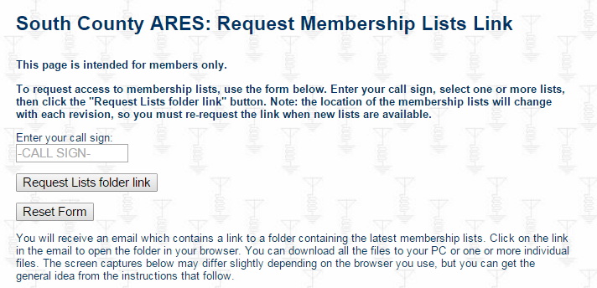
Request link to Rosters folder
Notes:
Go to the page on k6mpn.org that allows you to request a link to the
latest membership lists (rosters).
Enter your call sign, click on the Request Lists folder link button.
Go to your email and click on the link provided.

Slide 8
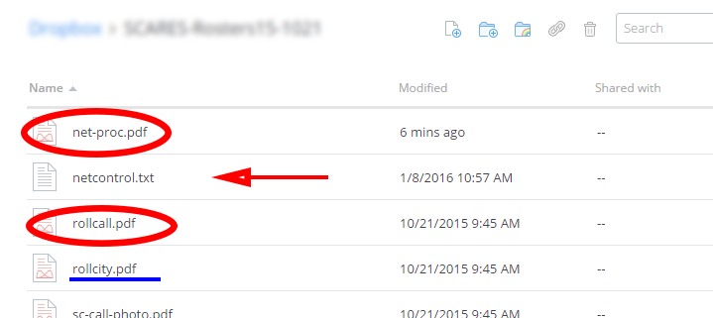
Download from Rosters folder
Notes:
There’s an advantage to using the Rosters folder, namely that you can also get the list of net control
Assignments.
The other advantage is that you can get the Roll Call by City file here, if you plan on doing Net by
City instead of by call sign.

Slide 9
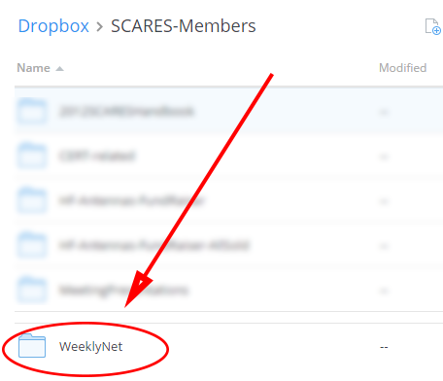
Download from Dropbox, pt 1
First, go to your Dropbox account and click on the folder “SCARES-Members”
Then, scroll down and click to open the WeeklyNet folder
Notes:
Go to your Dropbox account
Click on SCARES-Members
Scroll down this list of folders and click to open the WeeklyNet folder

Slide 10
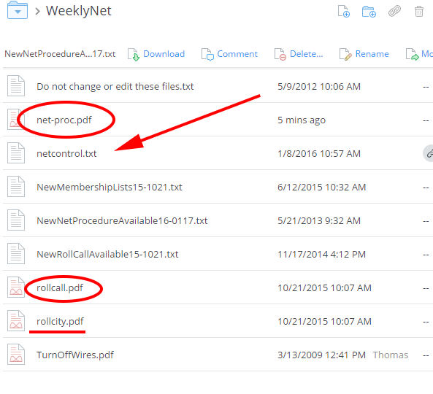
Download from Dropbox, pt 2
Download the Net Procedure and Roll Call files.
You can also get the list of coming Net Control assignments to look up next week’s NC.
Notes:
In the WeeklyNet folder, download the Net procedure and roll call. You also can get the list of coming Net assignments and roll call by city if you want to use that for Net.
Notice that this folder also has a quick way of telling when the Net Procedure and roll call files were updated.
It also contains information on how to turn off wires in case you have to help a station do that during Net.

Slide 11
Who is Net Control next week?
Best option: look in netcontrol.txt file
  Rosters folder
  Dropbox WeeklyNet folder
Next best: send email to netcontrol-at-k6mpn.org
Worst: check latest newsletter

Slide 12
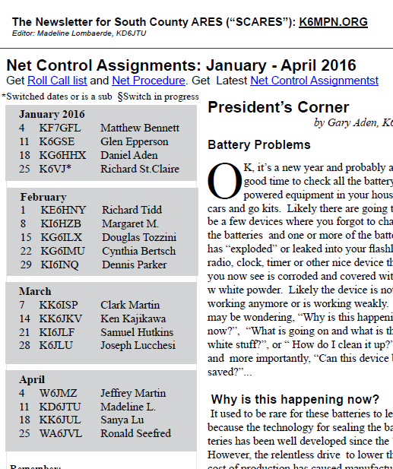
NC List in Newsletter
Often changes right after publication
Use only as last resort

Slide 13
Before Net
Get to EOC around 7 pm
Start up equipment and ask for a radio check
  Don’t make changes to radio settings
  Pre-set memories for K6MPN and 2m simplex
Organize your supplies and paperwork
2 meter remote base link: 7:15pm
Ask for Relay starting around 7:20pm
Don’t ask for early check-ins
Notes:
Try to arrive early. One time, the key for the Belmont EOC was missing and it took 25 minutes to find it.
At most installations, you just have to turn on the power supply to start up all the radios. Look for signs posted in the radio room about how to turn things on. Don’t turn off radios individually at Redwood City and Belmont. Use the power supply. Ask the EC about the set up at other city installations.
Don’t change the radio settings unless it’s absolutely necessary. All EOC radios are pre-set to be on the K6MPN repeater and the SCARES simplex frequency.
Ask for a radio check and a time check if there’s not an atomic clock available. Your cell phone may have the latest time (if it’s automatically updated by the carrier).
If you haven’t already done so, fill in the italicized words with your information and finish it before net starts.
The link comes up around 7:15pm. Listen for the announcement ... try to not be transmitting when it starts. Test the link once it’s up: look for signal strength bars on both frequencies to come up.

Slide 14
During Net
Start the Net on time
Calmly read the Preamble
  Don’t rush
  “Let it drop ..” Drop repeater after long paragraph
  Let go of PTT to listen
Start the Roll Call
  If by call sign, read the opening paragraph as is
  If by city, mention that roll call is in city order
Notes:
It’s important to start on time or folks will be wondering what’s going on ... is there a problem with their equipment, your equipment, the repeater?
If something delays you, make an announcement or have someone else make it.
Take a deep breath, relax, and calmly read the Preamble:
don’t rush, stay calm
speak at a slower than normal pace
let the repeater and link drop after long paragraphs: let’s the repeater timer reset. This also allows high priority or emergency traffic to break in.
Once you hear the short beep, the timer has reset and you can key up again
release the PTT button to listen for emergency/priority traffic: it’s “Push to Talk”, not “Push to Think”
listen for ARRL officials; if an official checks in and has traffic, allow them to go ahead with their traffic. But, there’s no need to ask if they have traffic. If they do, they’ll let you know.
Review opening paragraph for Roll Call
Roll Call by call sign: have the option of doing it in reverse alphabetical order. Mention this when reading the opening paragraph.

Slide 15
Filling Out the Form
Three parts
Top: record before Net
Middle: record check-ins during Net
Bottom: record totals after Net
Return to KD6JTU
  Fax
  Photo sent by email
NO SUBSTITUTES, PLEASE
Notes:
The Roll Call form has three parts to it:
Top portion: fill this out before net
Middle: fill this out as you check stations in. Note: before Net, mark your own line with “NC”
Bottom: total up the number of members (including yourself) that checked in to Net, the number of guest (non-member) stations and record the totals at the bottom.
Last step: send the completed form to Madeline KD6JTU
PLEASE, don’t substitute your own “form”. Use the one supplied, just like you’d have to use an agency’s form whether you like it or not.

Slide 16
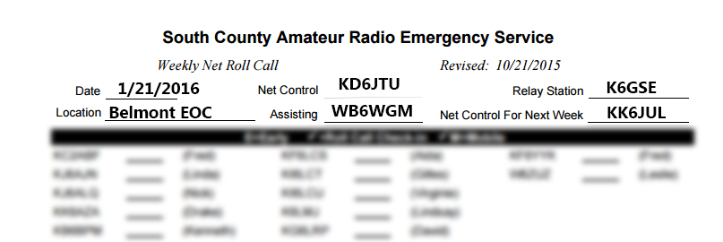
Top of Roll Call Form
Fill out before Net
Hand-written is fine, please print
If at home, enter “Home, <my city>

Slide 17
Middle of Roll Call Form
Before Net, mark yourself with “NC”
Check mark only the stations that checked in
Don’t use circles or other markings for non-responding stations
Use white space at right for guest check-ins
Tip: put “T” by stations with traffic
Notes:
You’d be surprised how many forms I get back where NC hasn’t marked themselves as having participated in the net.
Do this before net and you’re all set.
Since I have to use the form to check if my record of check-ins matches yours, please only mark the stations that check in.
Don’t put a circle if nothing was heard from a station. If you need to keep your place, use a tiny dot.
Some members like to mark a “T” by a station that has traffic for the net.

Slide 18
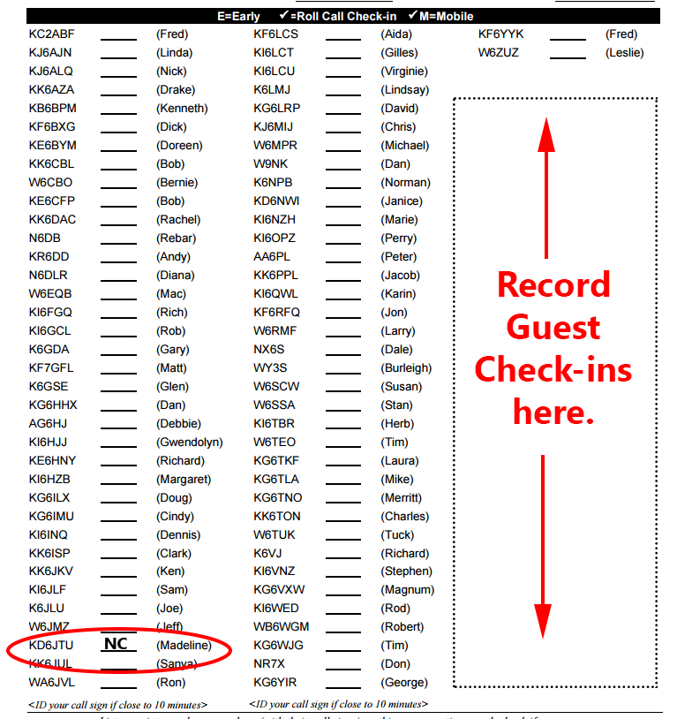
Mark The Check-ins
Notes:
Mark yourself as NC before net.
Mark check-ins as you go … guests go at right.

Slide 19
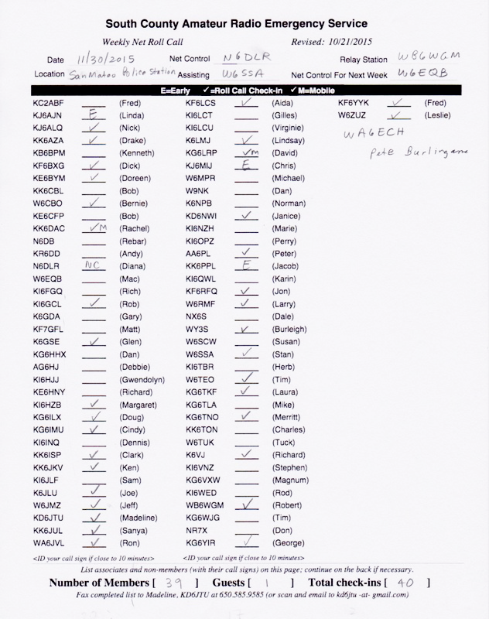
Like This …

Slide 20
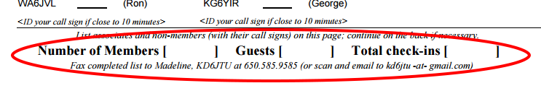
Bottom of Form
After Net, count the number of member check-ins and guests
Record the counts and total at the bottom
Return the form to KD6JTU
Notes:
After Net, count the number of check-ins, members and guests, and fill in the bottom of the form.
Total the two numbers, too.
I used that as a first check as to whether I got the same check-ins as you did.
Why do we record check-ins?
It’s a requirement to routinely check-in to Monday Night Net
If we don’t hear from a member for > year, we contact them to see if they’ve moved, lost interest, too busy, …

Slide 21
Roll Call Do’s, Part 1
Hold mike button for 1 second before speaking
Call by call sign only or city
  NOT phonetically
  NOT with name (use at acknowledgement)
Acknowledge check-in or say “Nothing heard”
If “Wires” is on, let the station know
Acknowledge traffic (“Traffic noted”)
Announce early check-ins
Notes:
Why do you have the wait 1 second before speaking
Allow link to come up
To check this, look at signal meter on radio(s)
Why not phonetically? Adds too much time to net
Don’t give call sign AND name: leave name for acknowledgement
Acknowledge check-in or say “nothing heard”
Let’s the member know if they were heard
Let’s relay know if you heard the check-in
Let’s the person recording the net in the database know that the member checked in (may not be able to hear all check-ins)
If they have “wires” on, you’ll hear a tone followed probably by the end of their call sign. Let them know “wires” is on: tell them to press PTT, wait 4 seconds, then give their call sign. Direct them to the k6mpn.org web site for directions on how to turn “wires” off.
Mark “T” by call sign of member who says they have traffic and acknowledge (“Your traffic is noted”)
Announce early check-ins: “<call sign> checked in early”
Allow your Relay to check-in in case they have traffic for the net
If the person assigned as next week’s Net Control checks in, confirm their assignment
Remember to give your FCC Call sign every 10 minutes. Roughly at the end of each column, but best to check the clock. Assistant can help with this. Don’t give it too frequently (some have done it every 3 minutes!)
Mark yourself on the roll call list (“NC”)
If someone doesn’t check in, please leave the line blank (don’t put a 0 or other mark; makes it hard to read)

Slide 22
Roll Call Do’s, Part 2
Allow your Relay to check in (might have traffic)
Confirm next week’s Net Control at check-in
  Station should end confirmation with call sign
  If no check-in, just announce and move on
Give your FCC call sign every 10 mins
(:40, :50, :00,...; ~ end of column)
Mark yourself on the list (use “NC”)
Notes:
Allow your Relay to check-in in case they have traffic for the net
If the person assigned as next week’s Net Control checks in, confirm their assignment
If you have an exchange with that station, make sure they end with their call sign.
Example: KD6JTU, please confirm that you will be net control next week. KD6JTU: “That’s affirmative. KD6JTU”
If they don’t check-in, just announce that they will be NC next week.
DON’T ask the net to “let them know”. Rod Hall KI6WED notifies everyone of their assignment several weeks in advance
Remember to give your FCC Call sign every 10 minutes. Roughly at the end of each column, but best to check the clock. Assistant can help with this. Don’t give it too frequently (some have done it every 3 minutes!)
Mark yourself on the roll call list (“NC”)
If someone doesn’t check in, please leave the line blank (don’t put a 0 or other mark; makes it hard to read)

Slide 23
Roll Call Don’ts
Don’t forget to wait 1 second after PTT
Don’t give call signs phonetically
Don’t say name along with call sign
Don’t ask each station if they have traffic
Don’t skip over your Relay
Don’t skip over early check-ins
Don’t mention when someone is out of town
Don’t give your FCC call sign too frequently
Notes:
Why do you have the wait 1 second before speaking
Allow link to come up
To check this, look at signal meter on radio(s)
Why not phonetically? Adds too much time to net
Don’t give call sign AND name: leave name for acknowledgement
Don’t skip over early check-ins: “<call sign> checked in early”
Don’t mention when someone is out of town: you never know who is listening
Some NC’s give their FCC call sign too often (every 3-4 mins)

Slide 24
Working with Relay
Relay will break in as needed (“Relay..”)
Weak signal check-in
  Ask station to try one more time
  Ask Relay
  Move on
Relay:
  “No Relay” – keep it simple!
  Give FCC call at end of each relay
Acknowledge relayed check-in
Notes:
You don’t have to ask relay repeatedly if they heard anything. Relay will break in with something like “Relay”. You respond with “Go, Relay” or “Go ahead”
[This is why we don’t key up quickly ... it allows Relay or high priority traffic to break in.]
When you can’t hear a check-in because of a weak signal, ask the calling station to try once more. If still can’t get it, ask Relay. If not able to get it, move on. Don’t start asking “Is that <call sign>?” or “Is that you <name>?” You can suggest they try a better antenna or higher power when you call for late member check-ins.
Relay should give FCC call sign at the end of each relay: “<call sign> checked in. KD6JTU”. Relay doesn’t know if they’ll be on again within 10 minutes. Or if no relays, “No relay, KD6JTU”.
Acknowledge the check-in so both the Relay and the member knows you got the relay.
Final note: ALLOW RELAY TO CHECK IN!

Slide 25
Late Member Check-ins
Roll Call by Call Sign
  Follow the Net Procedure as is
  Can wait until multiple check-ins end
  Acknowledge each check-in.
Roll Call by City
  Request members to check in giving their city first, then their call sign and maybe name
  Alternative: quickly go through the city list
Ask for relay at end
Notes:
This part can get hectic and is when an assistant can be the most help.
Some folks write down the calls as they come in, then mark the list as they give the acknowledgement to each.
When doing roll call by city, request the late check-ins give their city first, then call sign. You might even want them to give their name to slow things down.
As an alternative, quickly go through each city asking for late check-ins.
Be sure to acknowledge each late check in so the member and Relay knows you heard it.
Ask for any relays at the end. Relay may break in also.

Slide 26
Associate & Non-Member Check-ins
Associates are inactive members who are no longer listed on the Roll Call lists
Read the section paragraph as is
  Emphasize that guests should go slowly
  Request each guest to give
    Call sign phonetically (slowly)
    First name
    Location
Ask for relays when no calls are heard
Notes:
Again, this can get hectic. You are in charge so don’t be afraid to ask that folks speak slowly. It’s a good idea to acknowledge by repeating the call sign, name, and location
Sometimes a station tries to check in but doesn’t have PL or the right PL. If Relay can contact the station, wait until Relay comes back to the Net before proceeding. NC won’t be able to hear Relay’s contact with that station.

Slide 27
Traffic
Go through the list of stations that said they had traffic for the net
  Go reverse alphabetically if that’s how you did the roll call
  “<Call sign>, go ahead with your traffic”
Make notes of traffic
  May have to relay to station that couldn’t hear it completely
  Optional: ask if any station needs a “fill” on the traffic
Station giving traffic
  Let the repeater drop every minute or so
    Allows emergency traffic to break in
    Allows the repeater timer to reset
  Ask for volunteers without asking permission from Net Control
  Clearly turn the net back to Net Control
    “That is the extent of my traffic. Back to Net Control”
    Give FCC call sign
Notes:
This is a directed net. When net control turns the frequency over to a station who wishes to give traffic, that station should proceed with all the traffic, including asking for volunteers when applicable. It is not necessary to get Net Control’s permission ... Net Control already gave it! Stopping to unnecessarily ask permission slows down and delays the net.

Slide 28
Invitation to Guests
Listen to Board member traffic in case this has already been done.
Be aware of meeting location changes
Can skip if no guests checked in
Notes:
Most meetings are at San Carlos City Hall. You need to know if the location has changed for the next meeting and change this section as needed.

Slide 29
Closing the Net
Invite additional traffic
Last call for member, associate or non-member check-ins
Thank your Relay station
Announce net control for net week
Give time/date of close of net
Release the frequencies
Notes:
Ask members to identify themselves as members so you know to look on the list
Don’t offer or request to contact next week’s net control. It’s each member’s responsibility to show up for their assignment.

Slide 30
After Net
At EOC/radio room
  Radio settings must be left on K6MPN and 2m simplex
  Shut down power to radio/equipment
  Shut off lights and lock if applicable
  Return key if applicable
At EOC/radio room or at home:
  Note total number of member check-ins
  Note total number of guests
  Fax roll call sheet to 650-585-9585 or send image to kd6jtu –at- gmail or give to KD6JTU at next general membership meeting
Notes:
Be sure to put the radio memories back the way you found them! You should not have to make any changes, but if you did, put the radio settings back the way you found them.
Don’t shut off radios individually: if they went on with the power supply, just turn off the power supply to shut them off.

Slide 31
Net Control Exercise
If there’s time, a table top exercise …
Notes:
If there’s time, we will conduct an NC exercise

