Slide 1
Smart Phone Applications for Ham Radio and Emergency Services
Maps and Apps
By Doug Beasley, W6CDO
Nov. 16, 2023

Slide 2
Agenda
Apps for Offline Use
Apps for Emergency Services and Information

Slide 3
Apps for Offline Use
Problem: In the event of widespread power/cellular outage, how do you navigate or know what repeaters to access?
→Map Applications let you download map files for use when you have no internet connectivity
Maps and Navigation
  Thomas’ Guide
  Google Maps (iPhone and Android)
  Apple Maps (iPhone)
  Compass and Elevation Navigation (iPhone)
Repeater Information
  RepeaterBook

Slide 4
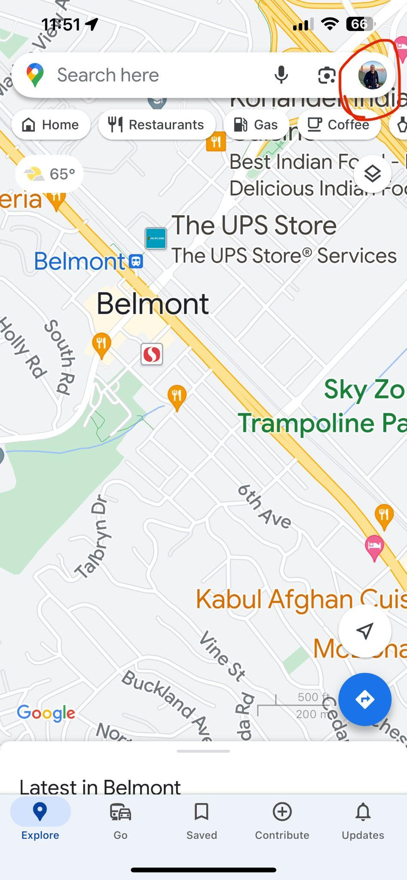
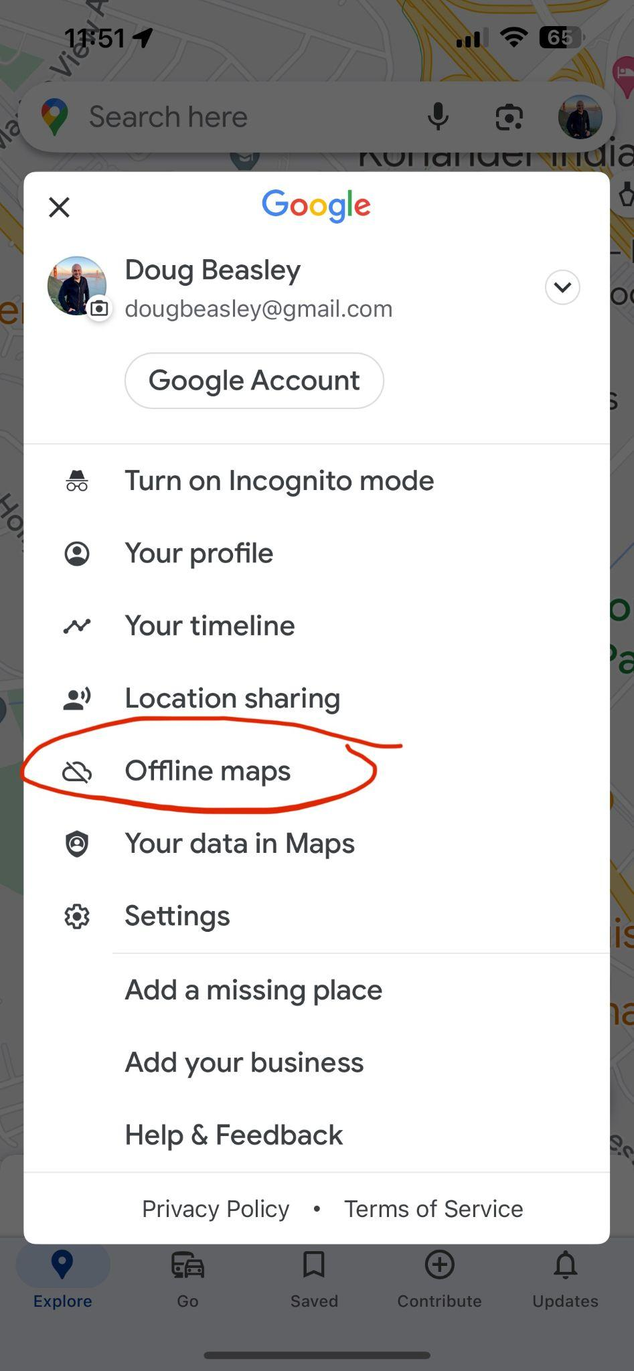
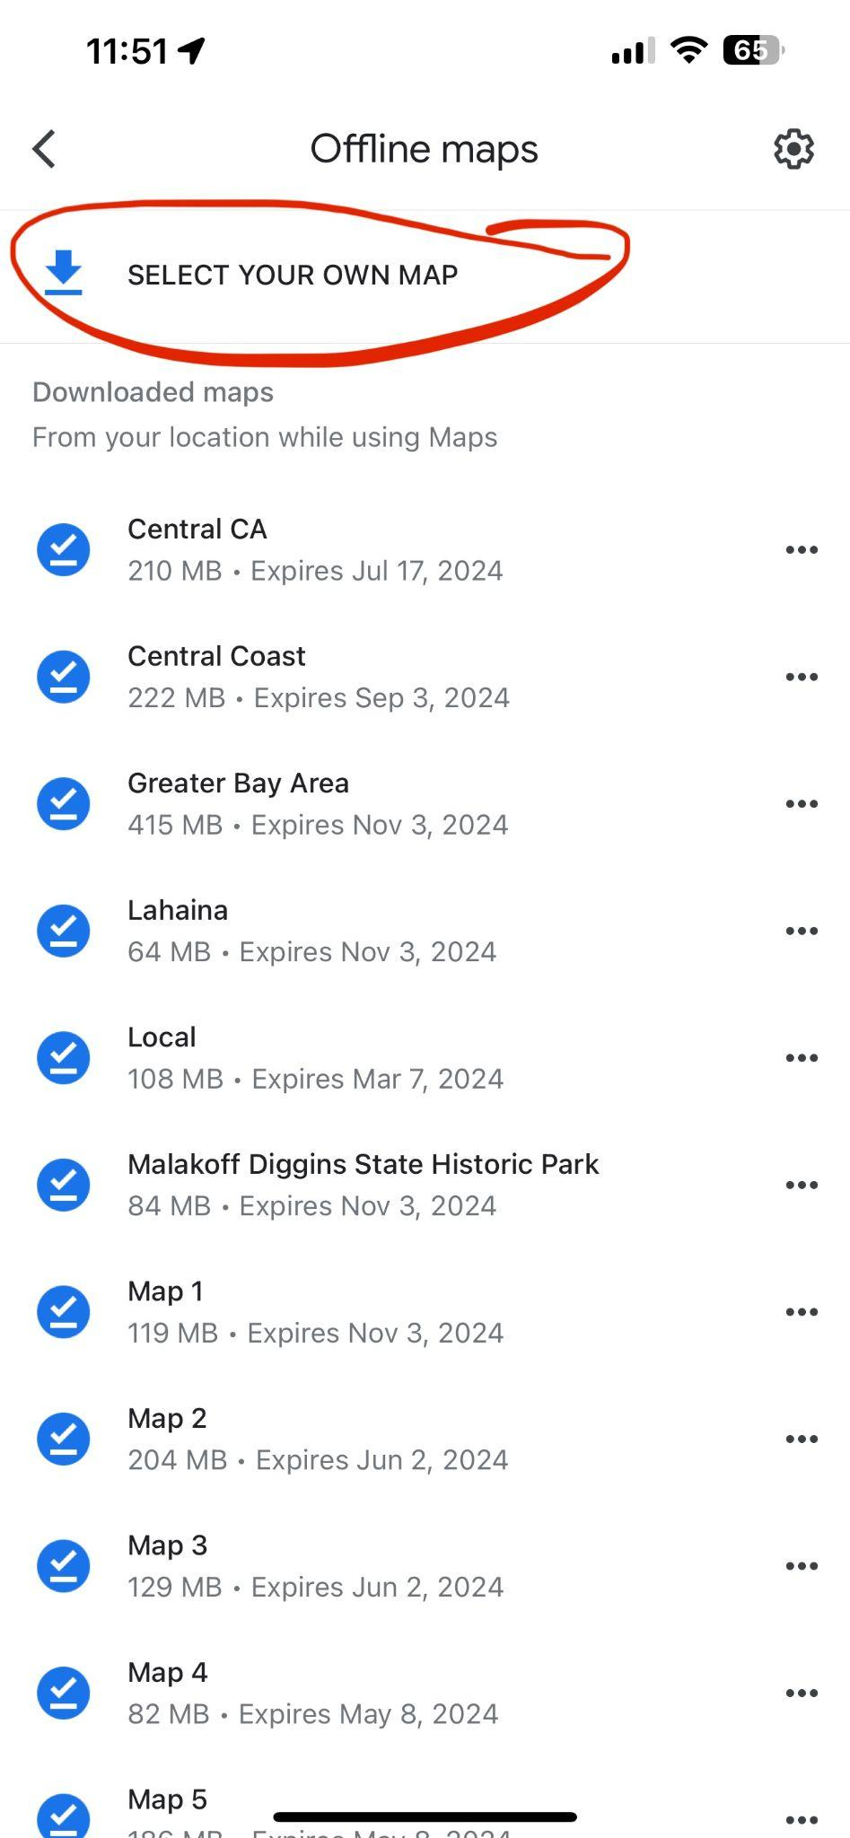
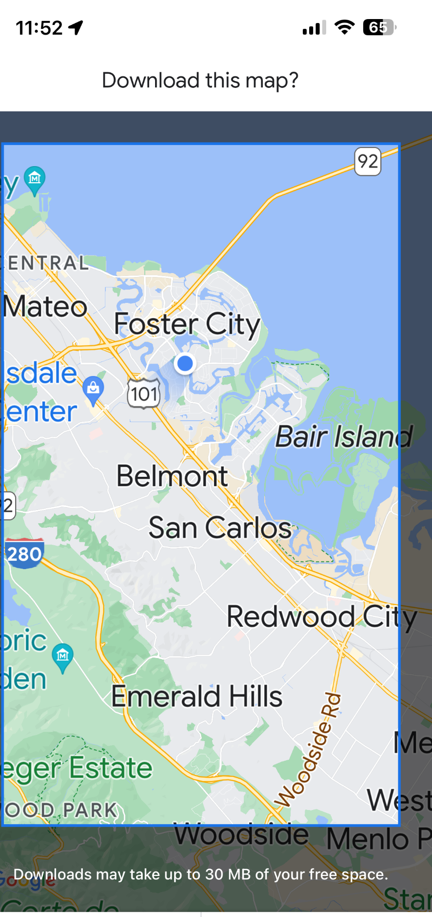
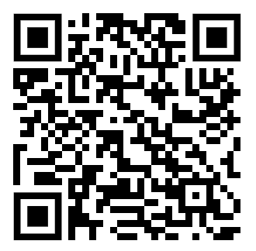
Google Maps
Scan QR code for Apple iPhone Download
1. Click your User Image
2. Select Offline Maps
3. Select Your Own Map
4. Select the Area you want to download

Slide 5
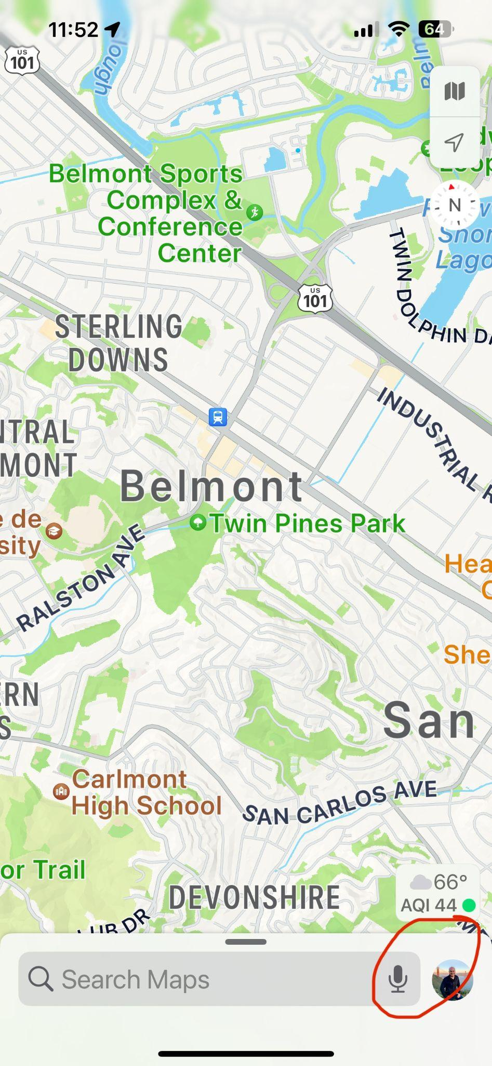
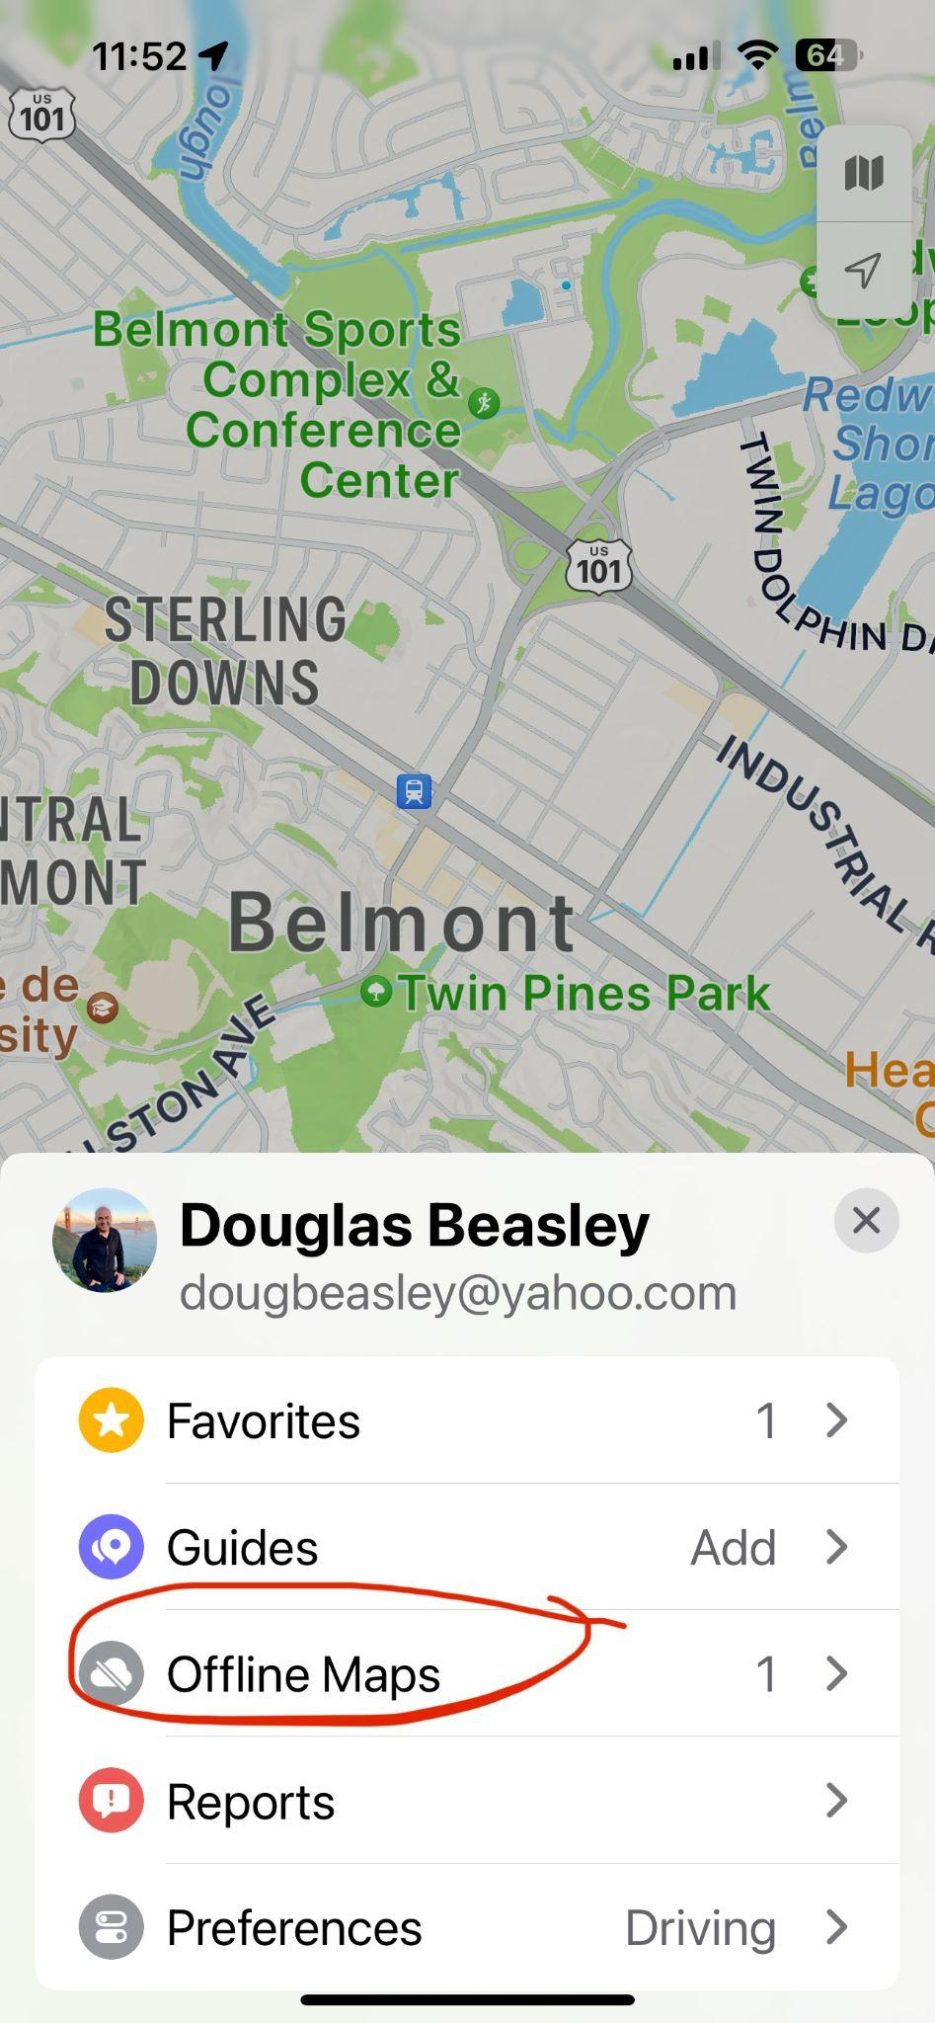
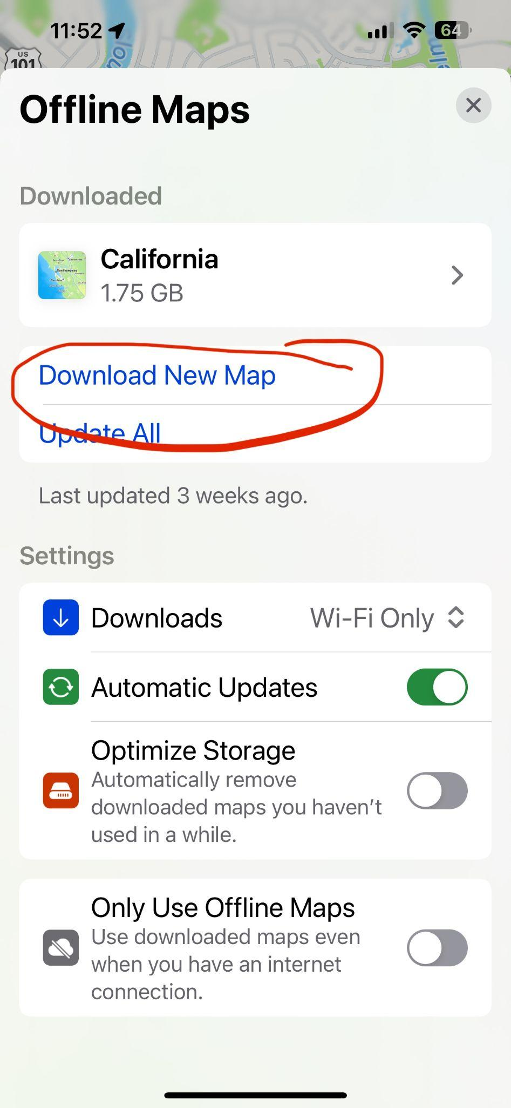
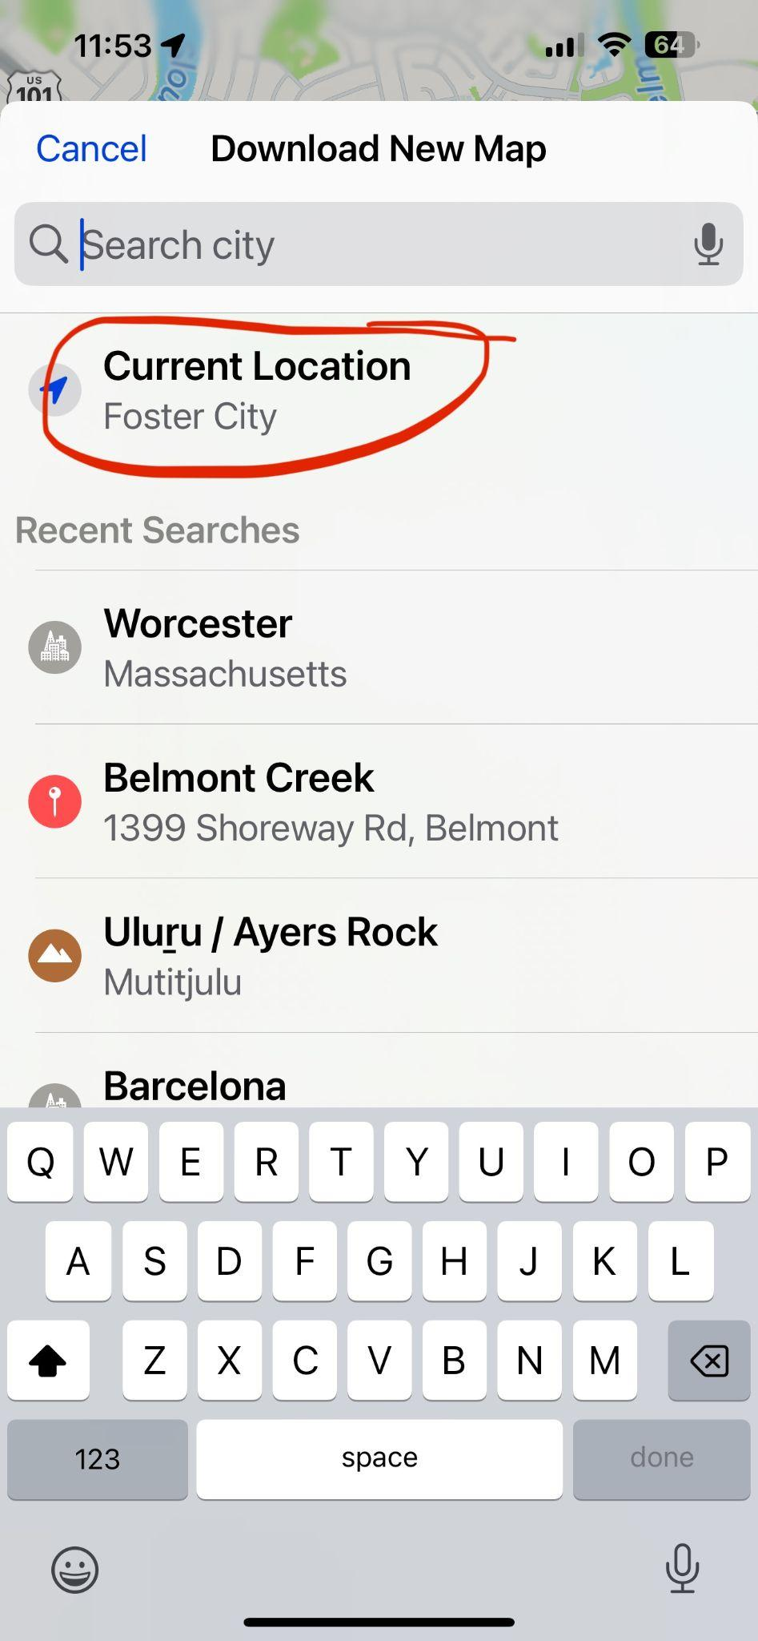
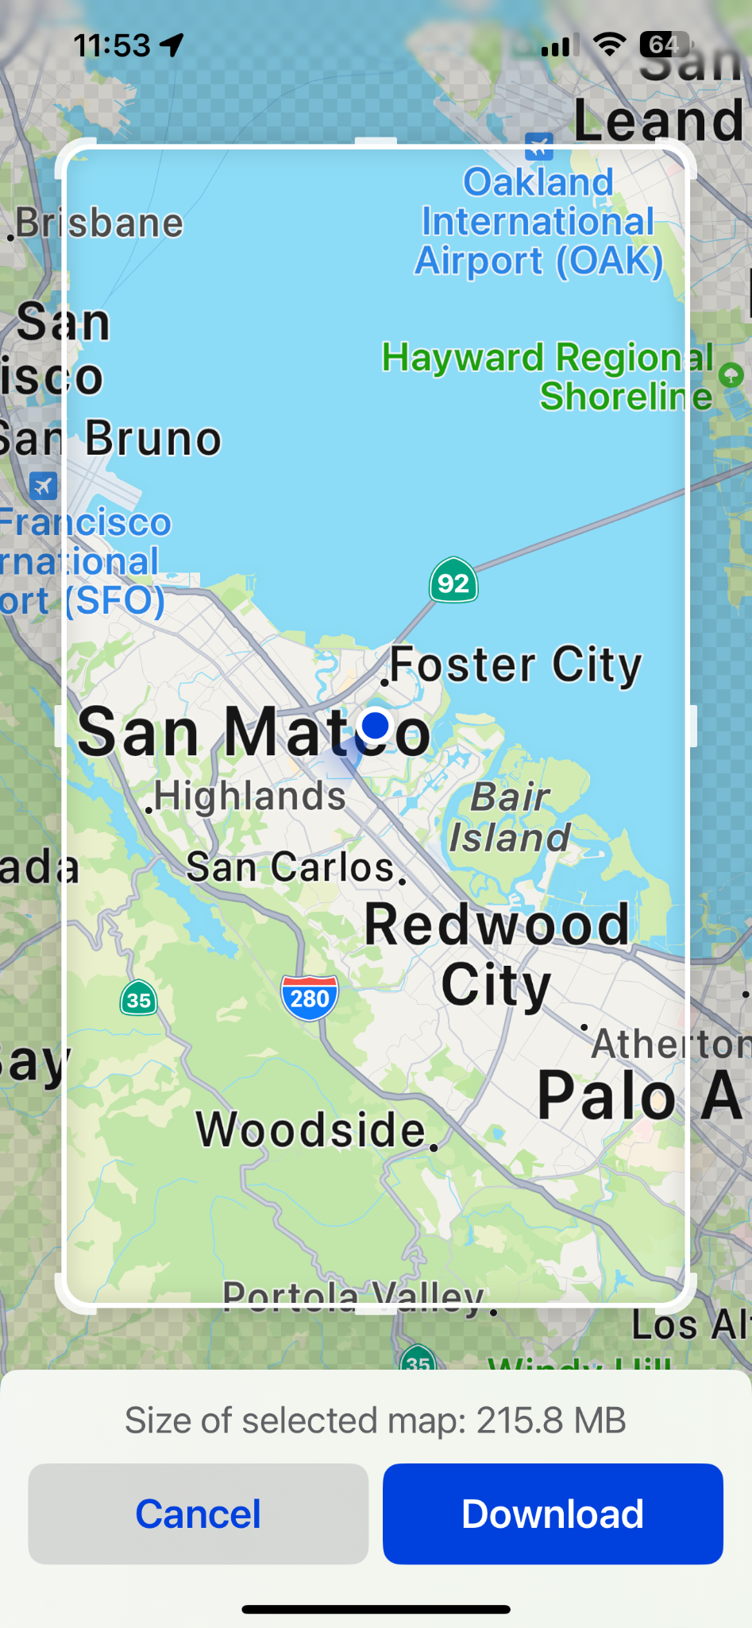
Apple Maps
1. Click your User Image
2. Select Offline Maps
3. Select Your Own Map
4. Select the Location
4. Select the Area you want to download

Slide 6
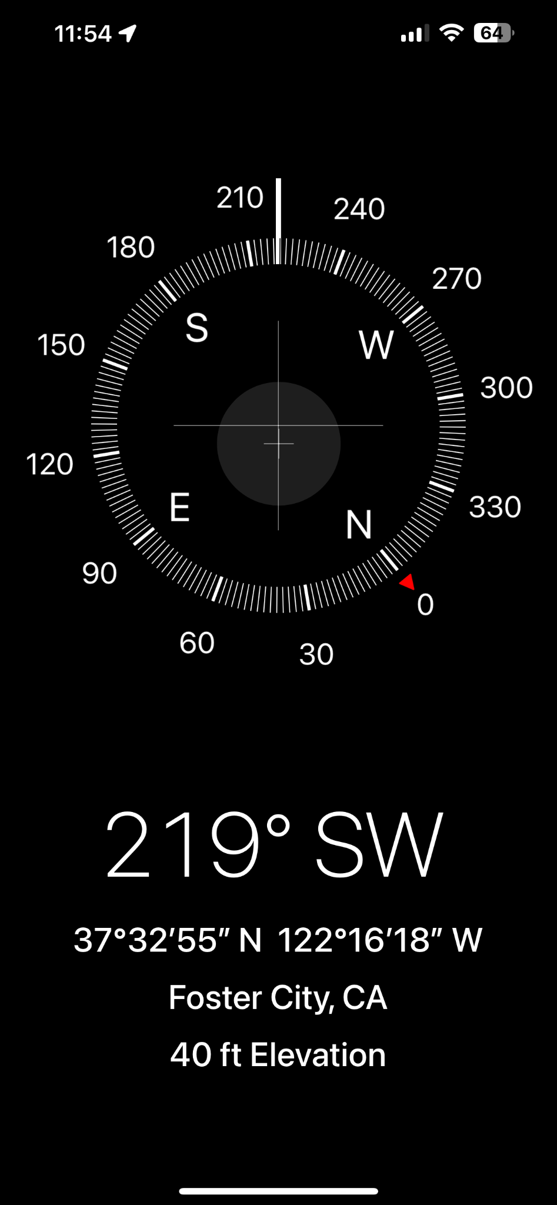
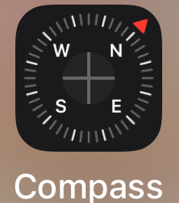
iPhone Compass App

Slide 7
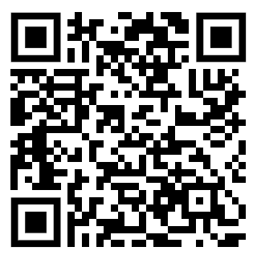
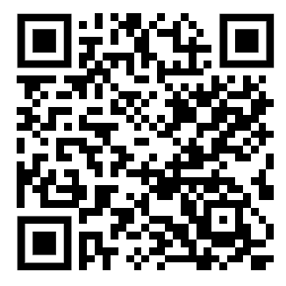
Repeater Book
Offline Access to Nearby Repeaters
Scan QR Code for Apple iPhone Download
Scan QR Code for Android Download

Slide 8
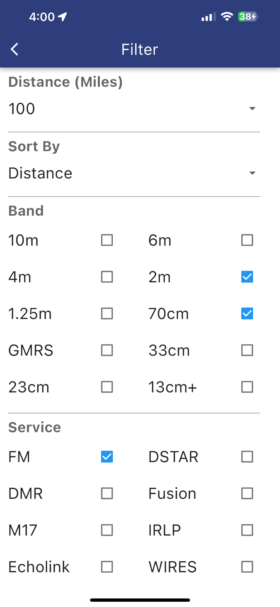
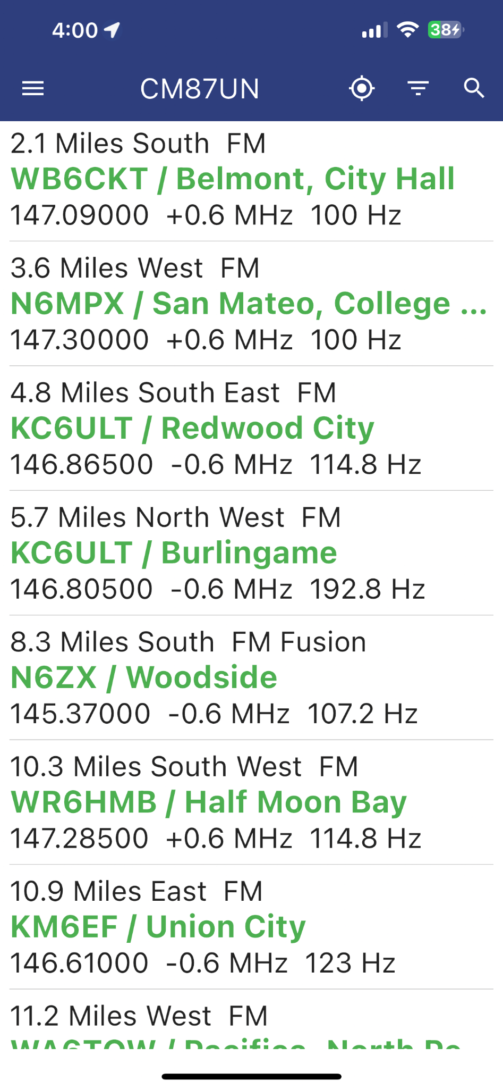
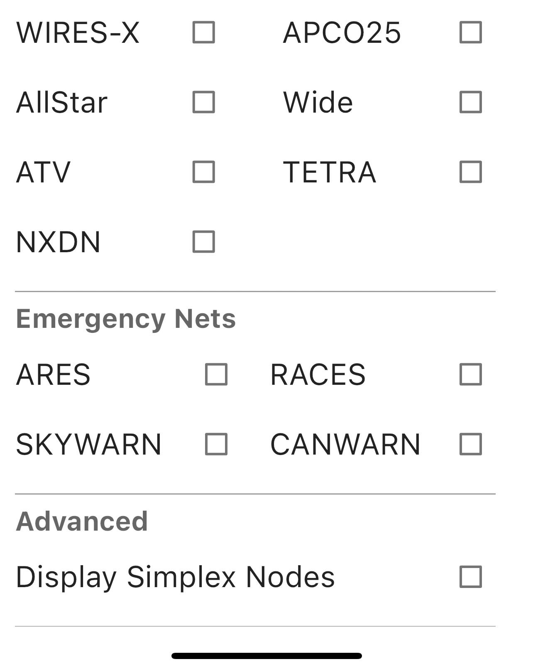
Repeater Book Examples

Slide 9
Apps for Ham Radio & Emergency Service Information
Useful apps to have an understanding of your present Emergency Services and Ham Radio Area of Operation
FireIncidents
5-0 Radio
Call Search
MorseDecodr
BeaconAid

Slide 10
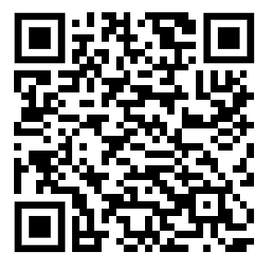
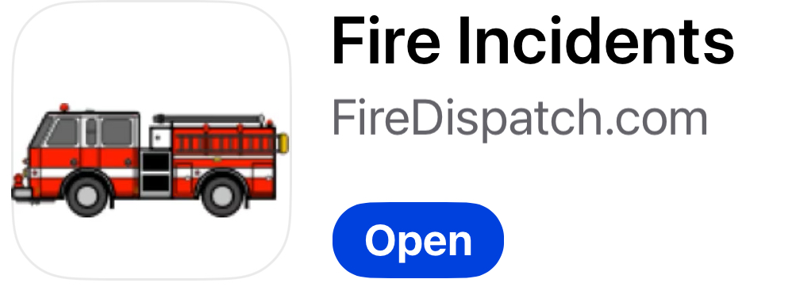
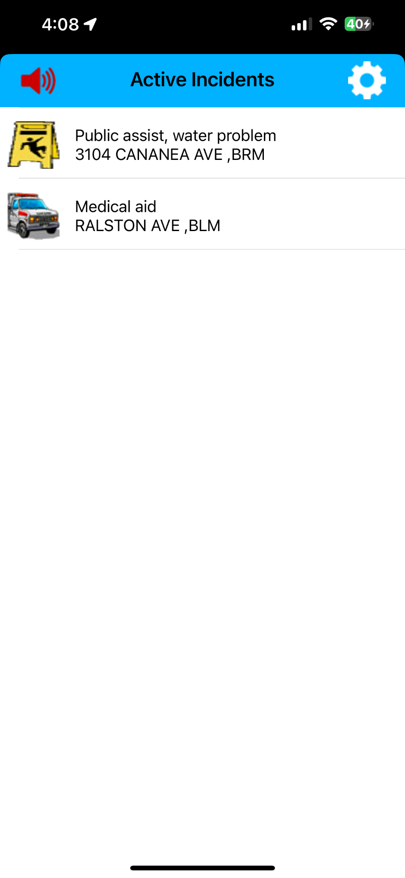
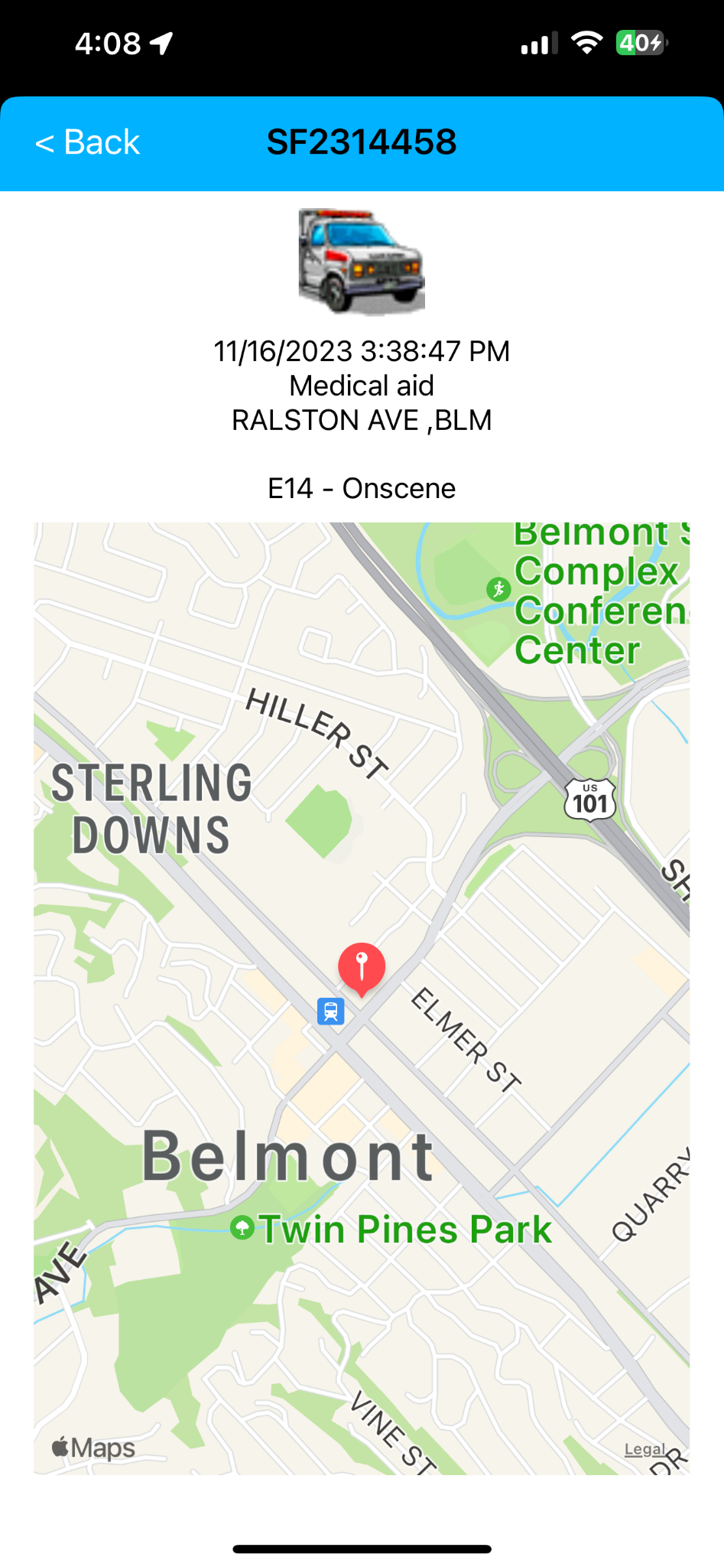
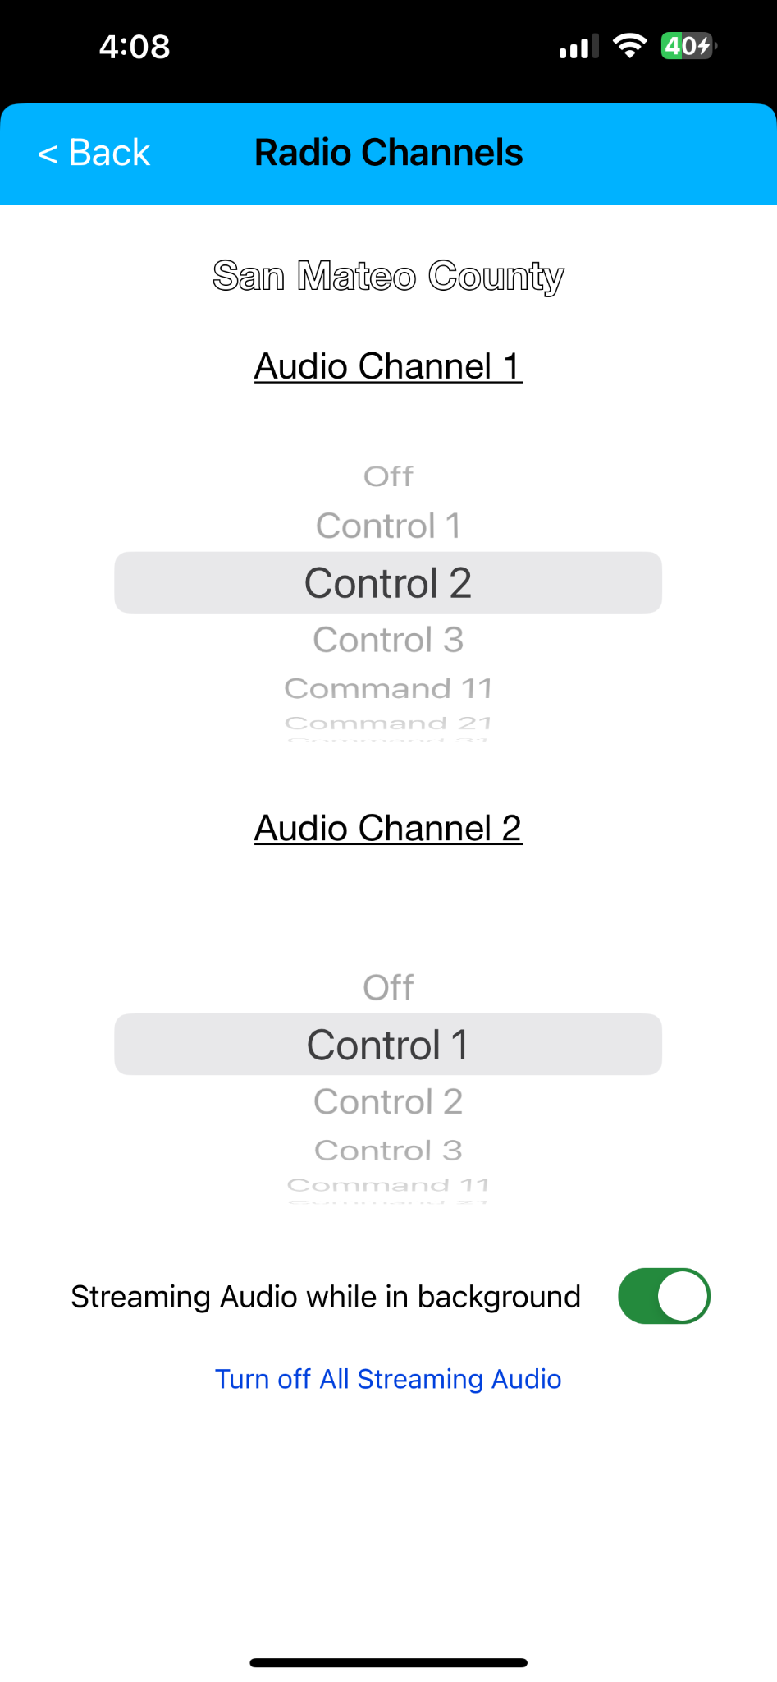
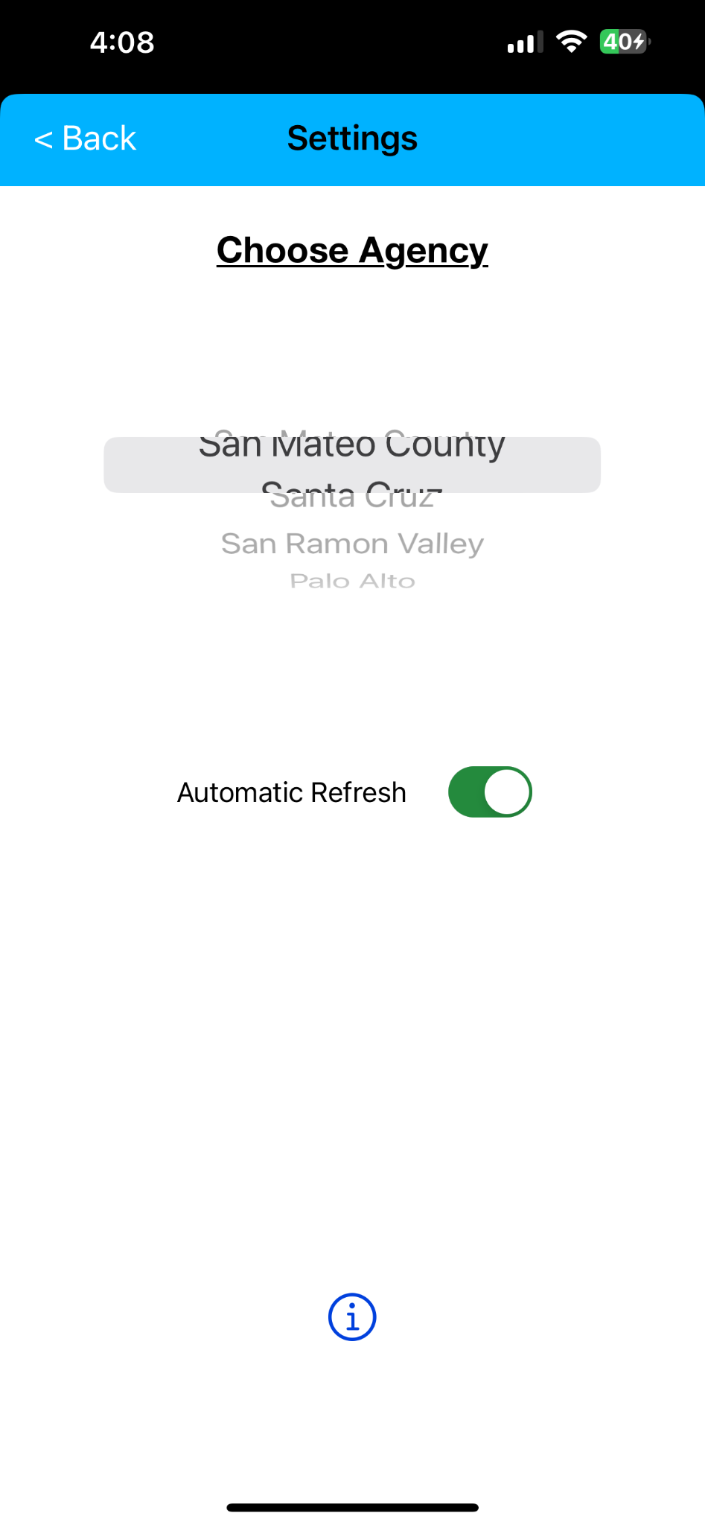
Fire Incidents
iPhone Download

Slide 11
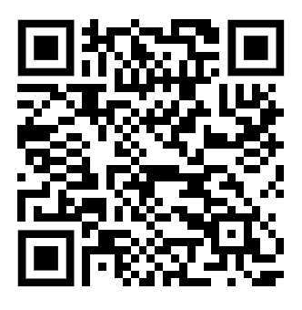
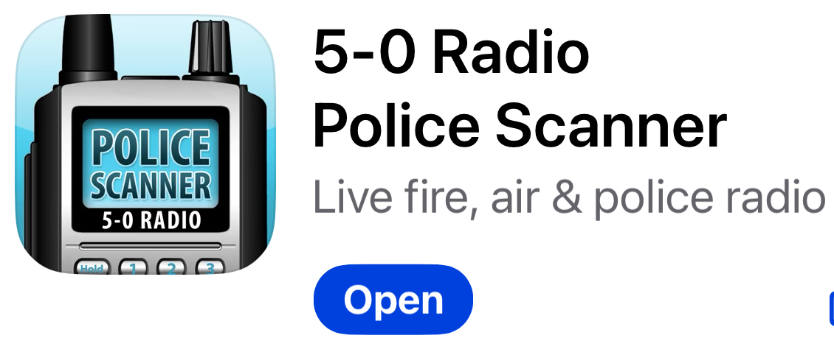
5-0 Radio
iPhone Download

Slide 12

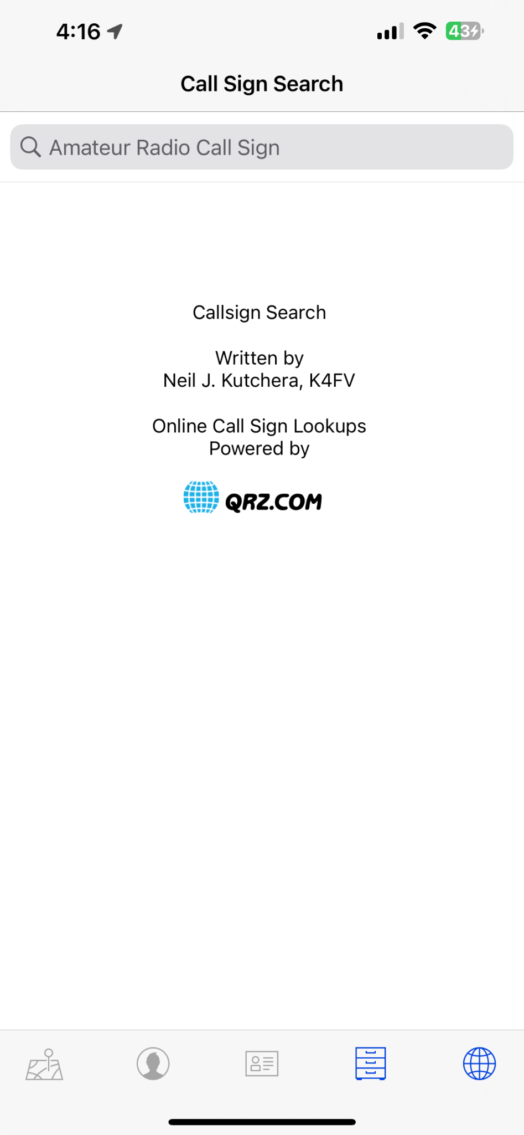
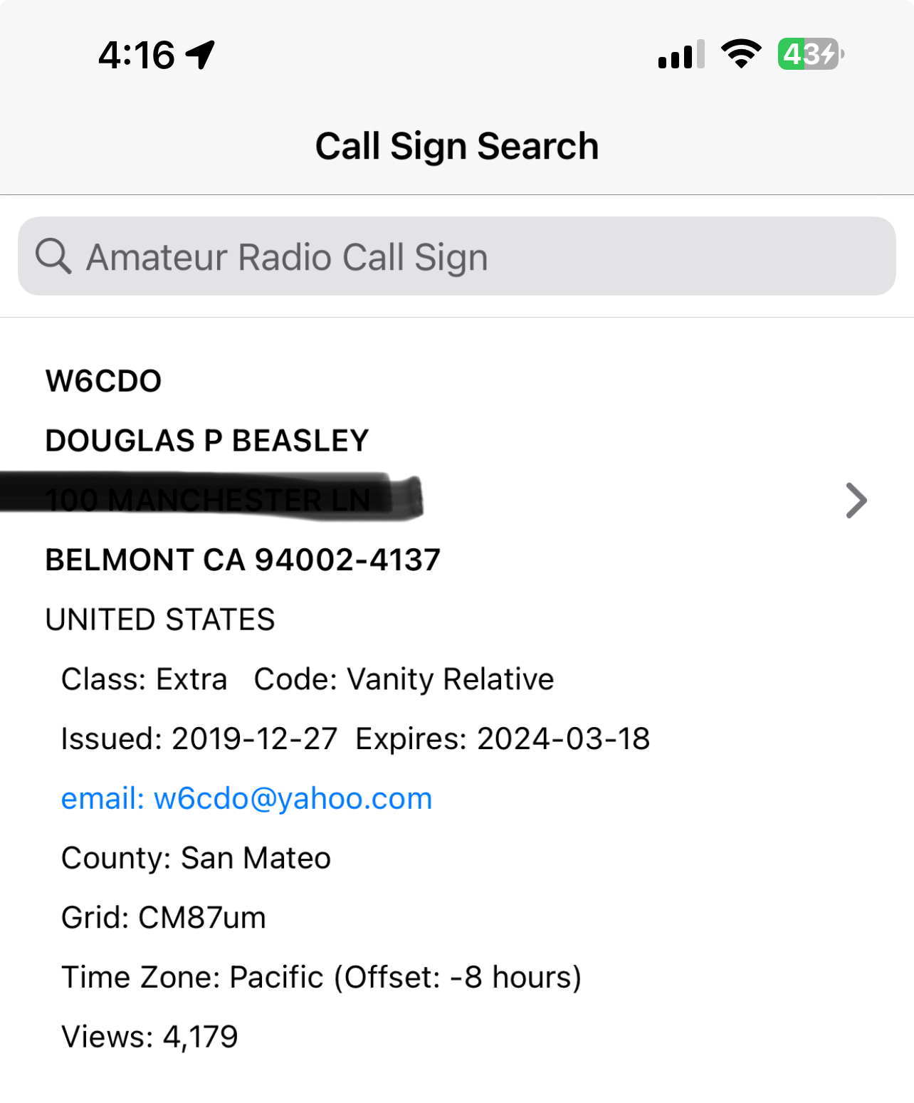
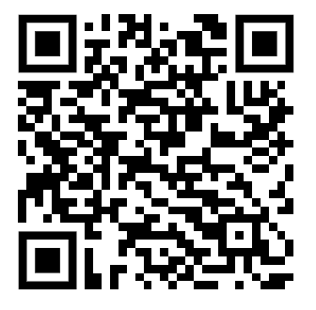
Ham Radio Call Sign Searching
iPhone Download

Slide 13
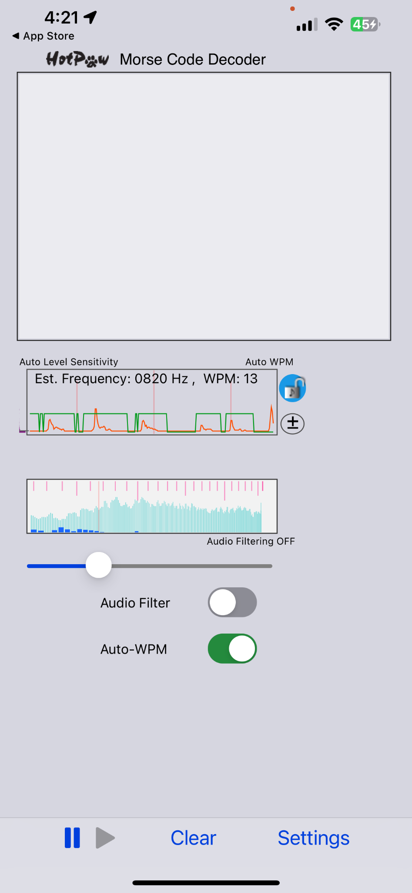
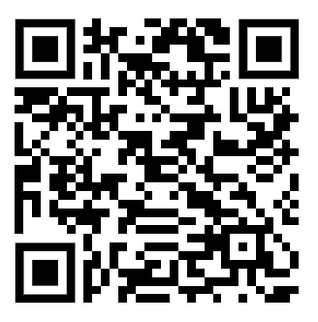

Morse Decoder
iPhone Download

Slide 14
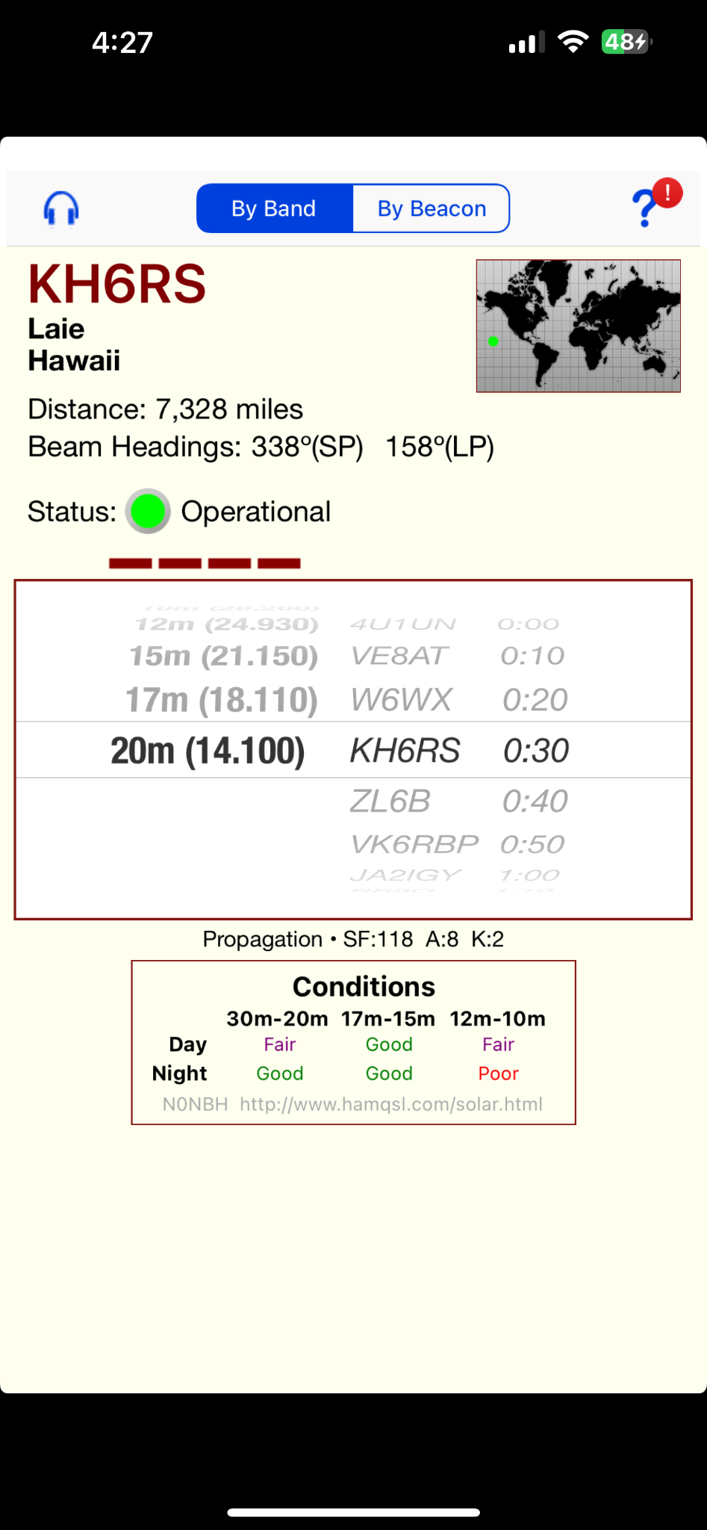

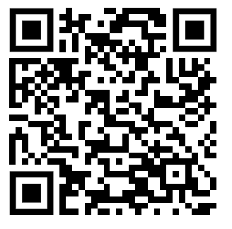
Beacon Aid - HF Signal Beacons by Band
iPhone App Download

Slide 15
Questions
Thank you!

