Slide 1
Repeaters, Remote Bases, Simplex
By
Robert (Bob) Lombaerde, WB6WGM
South County ARES
21 Nov 2024

Slide 2
Presentation Outline
Introduction
What is a repeater?
What is a Remote Base?
SCARES repeaters
Repeater diagram details
Nuances
Propagation
Questions

Slide 3
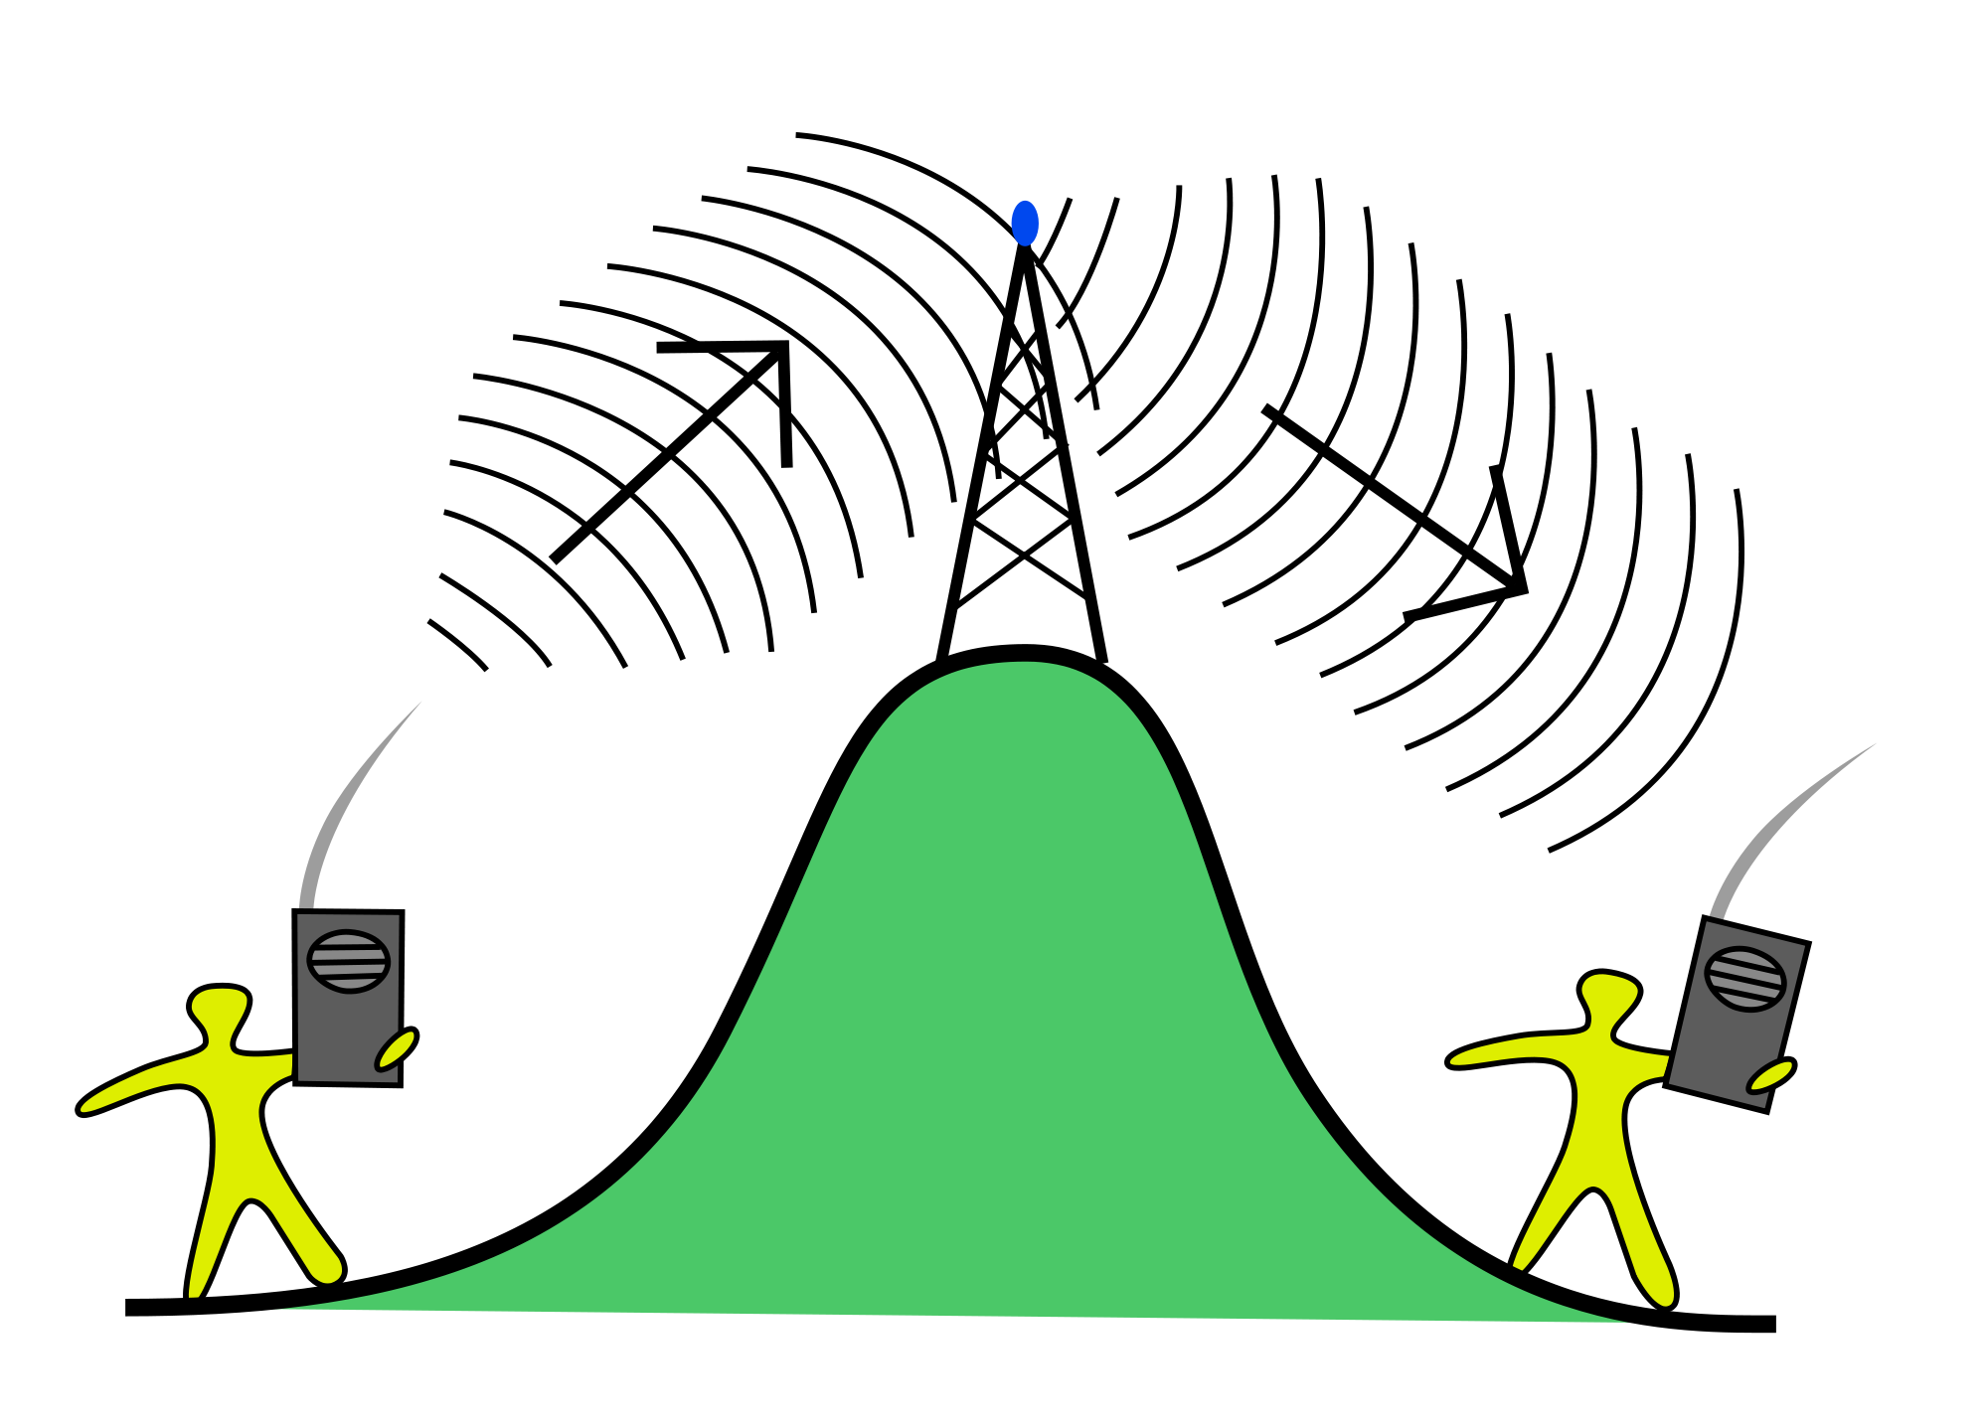
Repeater:
Receives on Frequency 1
Transmits Simultaneously on Frequency 2

Slide 4
SCARES repeaters
Number of SCARES repeaters - 3
Frequencies
444.5+ MHz PL 100 Hz
53.68- MHz PL 114.8 Hz
Locations
Hall of Justice RWC (primary 444.5)
RWC PD (aux repeater 444.5)
Kings Mountain Fire Station (53.68)

Slide 5
What the repeater user needs to know
Repeater’s output frequency
Repeater’s input frequency (or offset)
CTCSS required to access the repeater?
Does repeater transmit CTCSS?
Is it an OPEN repeater?

Slide 6
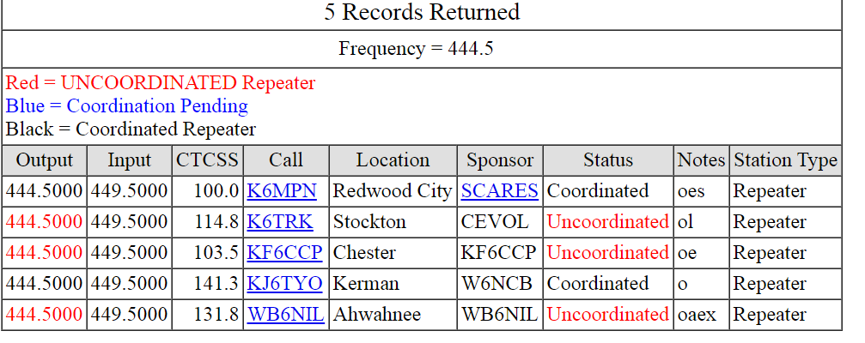
NARCC
Northern Amateur Relay Council of California

Slide 7
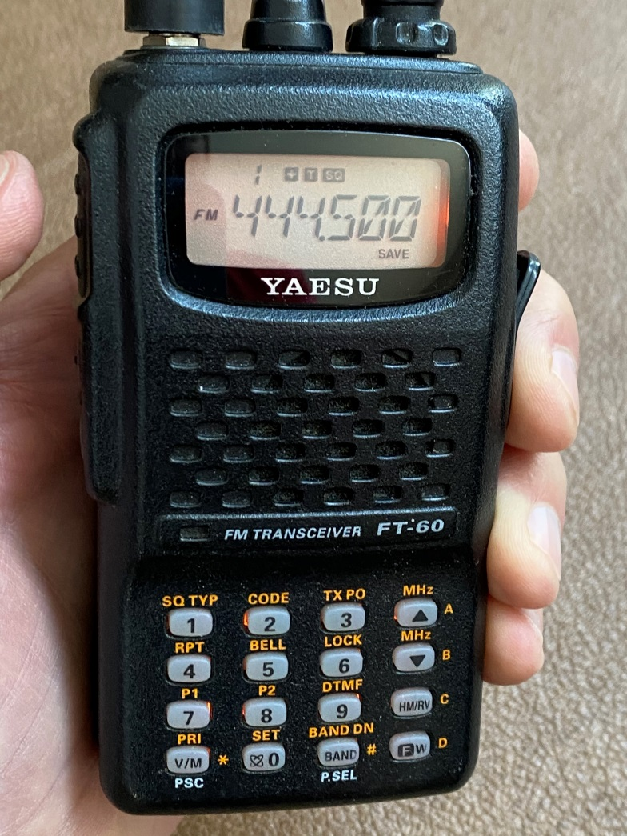
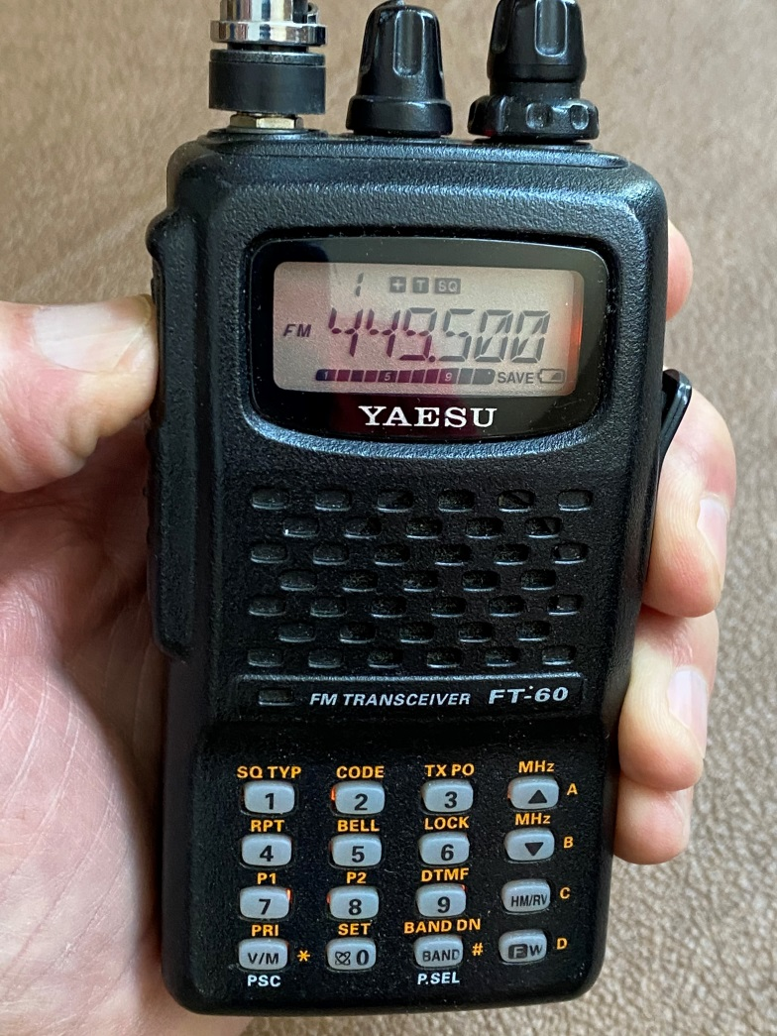
Repeater offset on radio
RTL
PTT
Receive Frequency 444.5
Transmit Frequency 449.5 (+5)

Slide 8
SCARES auxiliary repeater
Located in RWCPD Ham radio room
On “hot standby”
Battery backup w/trickle charge
No Remote Base
Commanded ON if HoJ repeater is down
Available as portable ? (not easy,heavy)

Slide 9
SCARES repeater in RWCPD
Diamond X-50A
UHF
Antenna
Yaesu Vertex VXR-5000 25 W UHF repeater
Pacific Research controller plugged-in
TX 444.5
RX 449.5
Duplexer

Slide 10
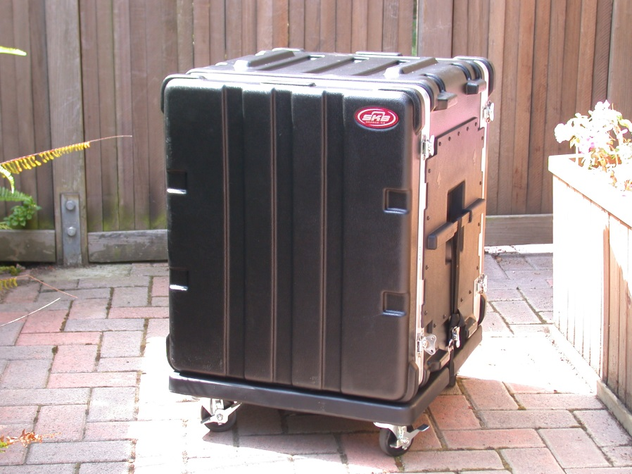
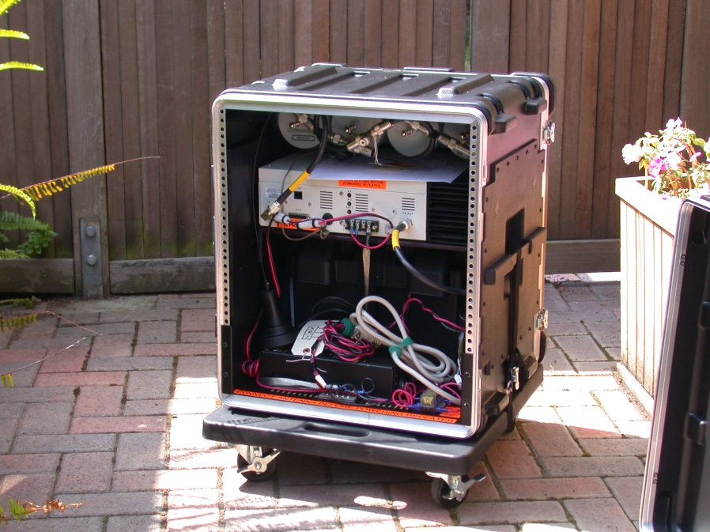
SCARES aux repeater

Slide 11
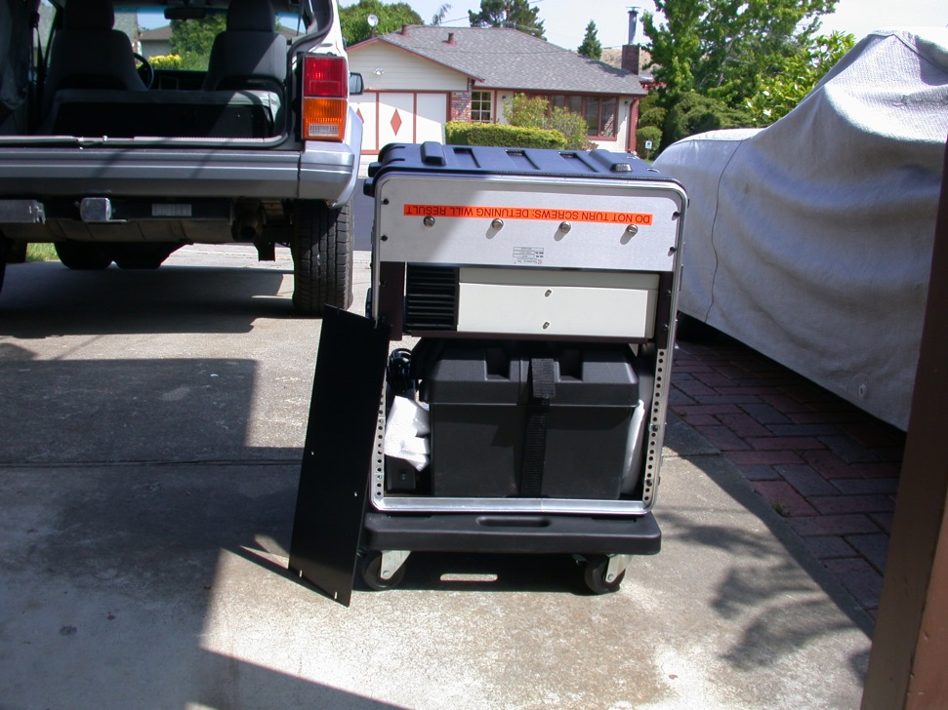
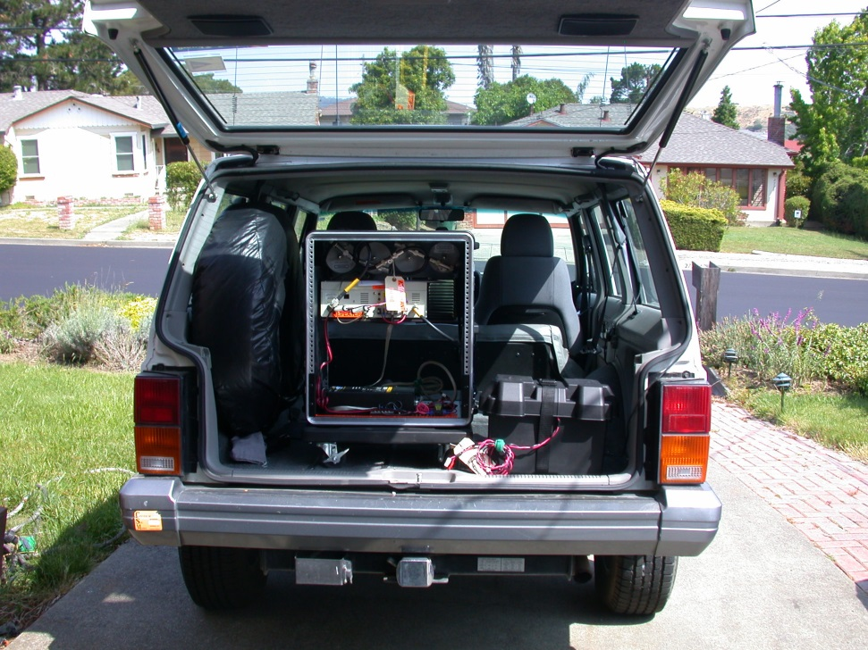
SCARES aux repeater

Slide 12
SCARES 6 m repeater
GE mobile transceiver configured as a repeater, 53.68- PL 114.8
Pacific Research Controller
No remote base
Battery backed up by KMF
Utilizes KMF 6m folded dipole antenna
SCARES 53.68 duplexer

Slide 13
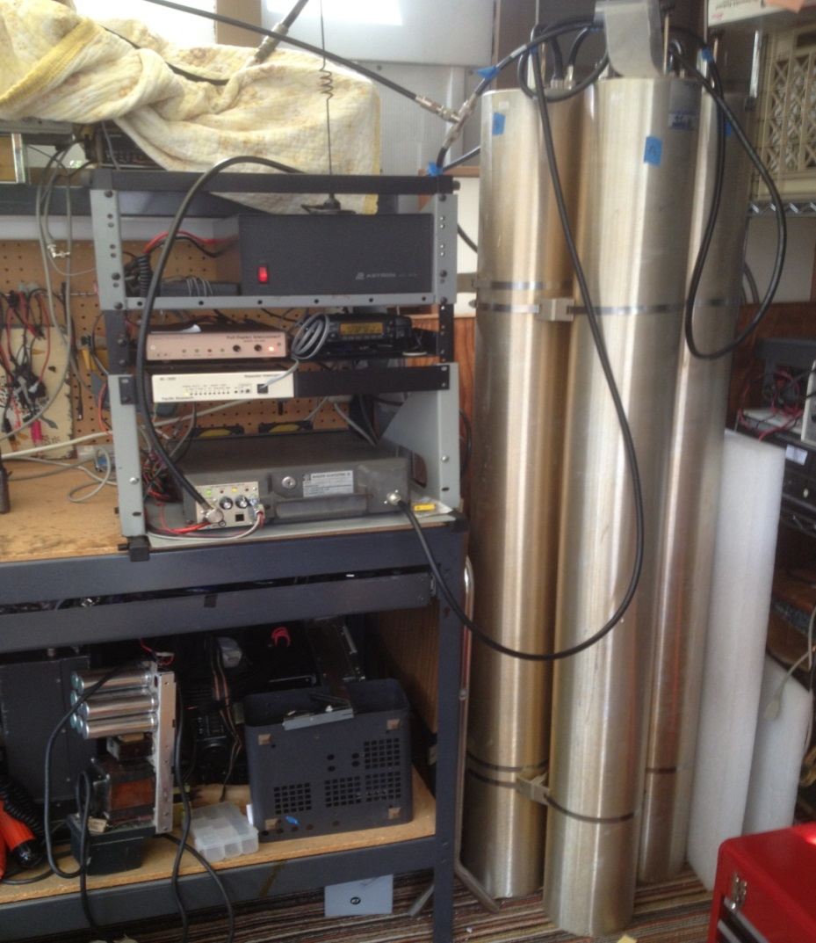
SCARES 6 meter repeater before KM install

Slide 14
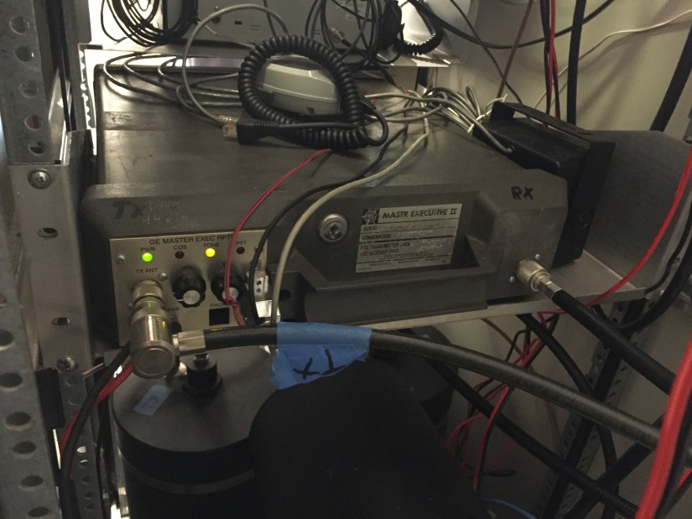
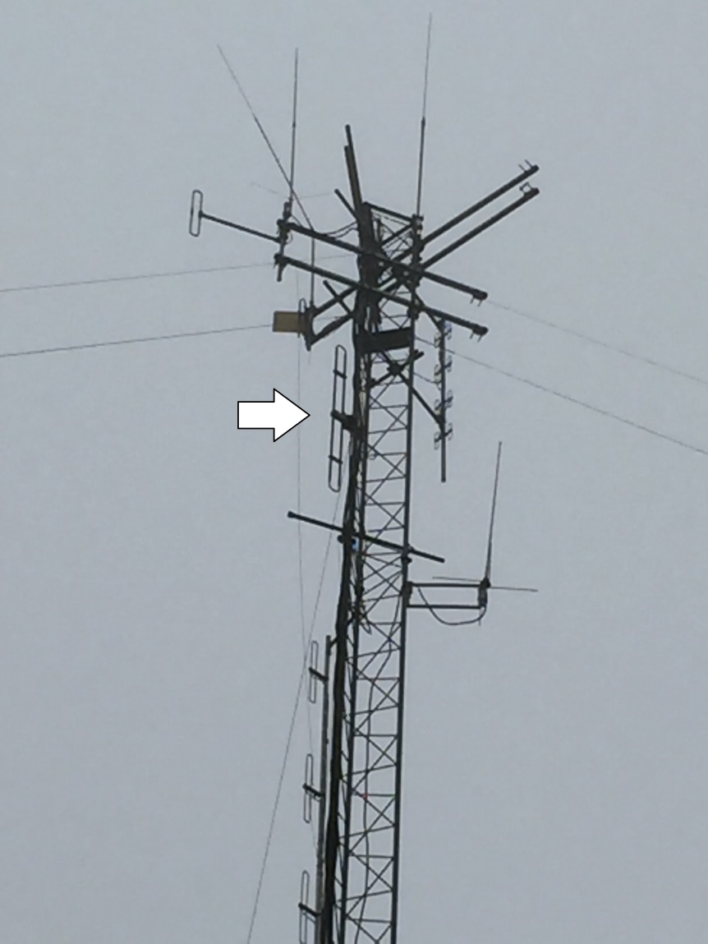
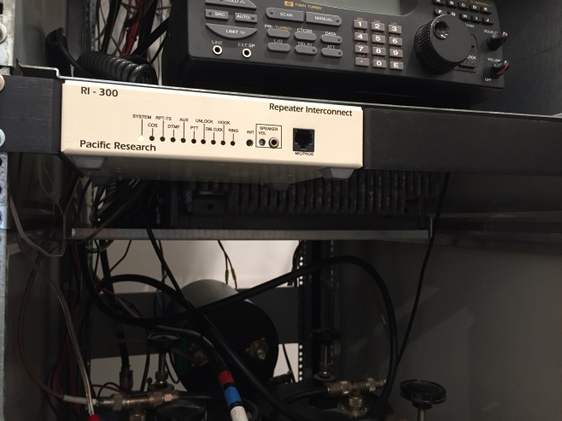

6 meter repeater at KM Fire

Slide 15
SCARES primary UHF repeater
Located atop the Hall of Justice in RWC
25 W Kenwood UHF repeater with DSP
100 Hz CTCSS both TX/RX
DB-408 dipole antenna configured for maximum gain along peninsula
Three channel Arcom RC210 controller
Kenwood 2 meter remote base

Slide 16
Remote Base ?
Remotely Controlled Base Station
A mobile 2m Kenwood TM-281 @25 W
Think of it as a base radio but located
at another site (at the repeater)
Controlled by the repeater’s ARCOM
controller

Slide 17
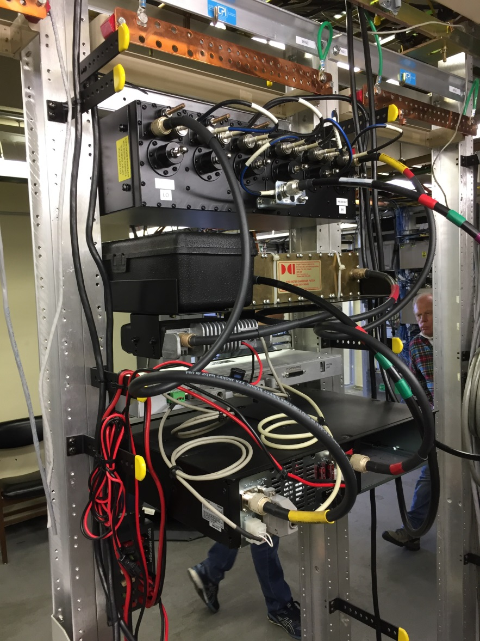
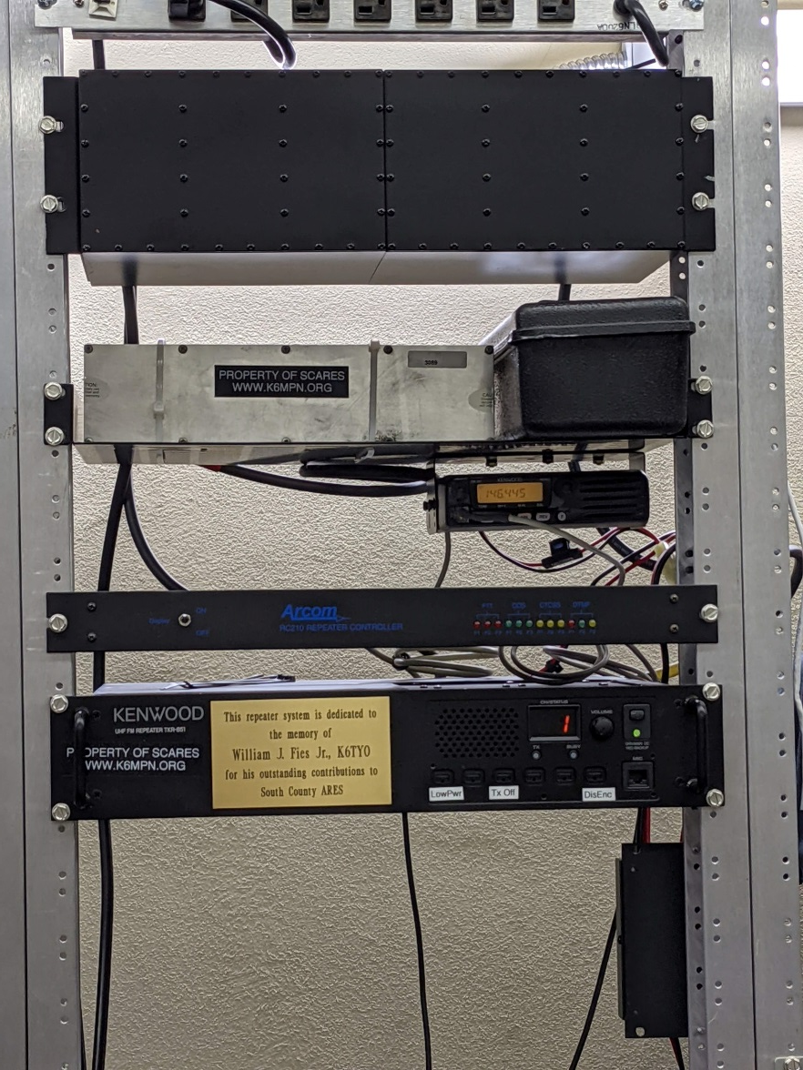
K6MPN primary Repeater
(front – back)

Slide 18
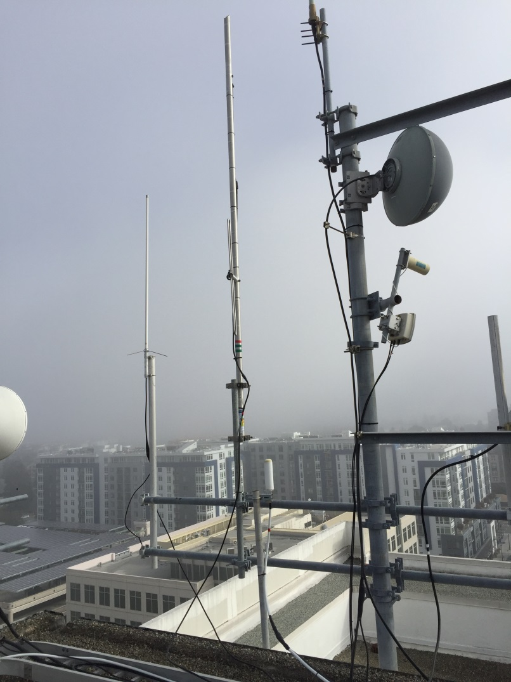
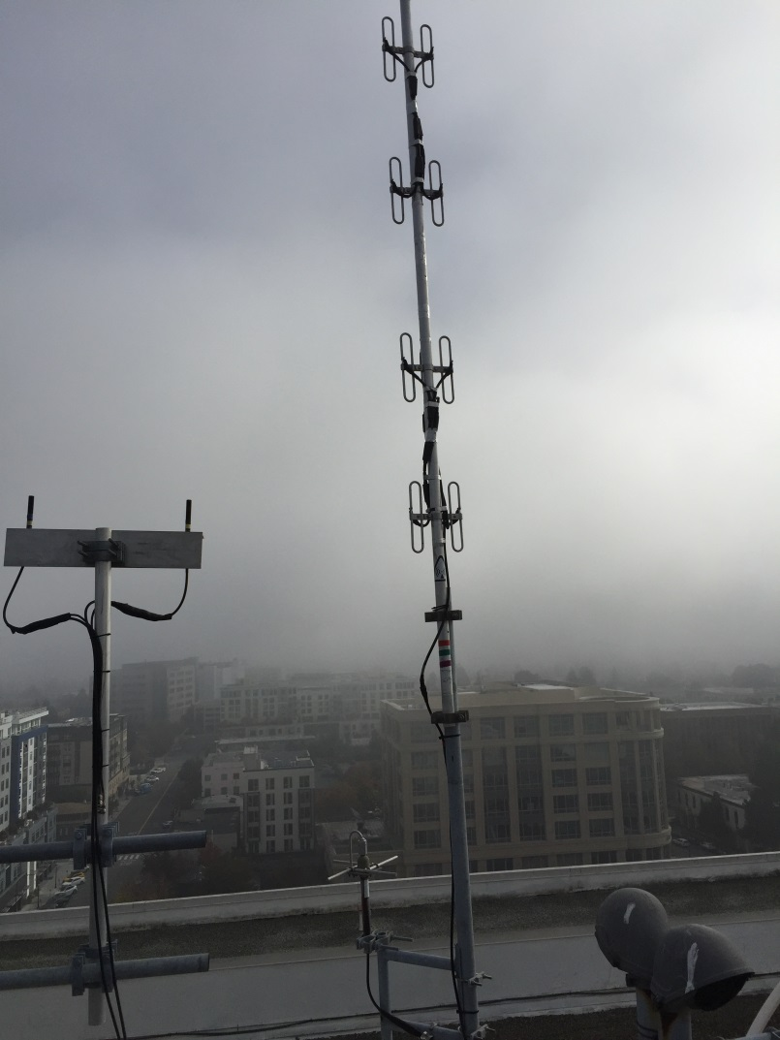
VHF and UHF antennas

Slide 19
SCARES Repeater on HoJ
DB-408
UHF
Antenna
DB-222
VHF Antenna
Arcom
RC210
Controller
PolyPhasers
filter
2m xceiver
Kenwood UHF repeater
TX 444.5
RX 449.5
Duplexer
DC power supply
UPS

Slide 20
Repeater Controller (basic)
Processes audio from the receiver
Sends processed audio to transmitter
Keys the transmitter
Inserts repeater ID (10 minute interval)
Has watchdog timer (shuts off TX if TX stuck ON or someone has “talked off” the repeater) 90 sec tx timer limit

Slide 21
SCARES repeater nuances
Announces net 5 minutes after the hour on Mondays from 0800 to 1900 hrs.
Announces general meeting 5 minutes after the hour every third Thursday from 0800 to 1900 hrs.
Turns ON remote base 1915 hrs every Monday for net and then turns remote base OFF at 2015 hrs.

Slide 22
SCARES repeater nuances-2
90 second time-out-timer
Short hang-time for Remote Base
Voice ID switches to CW if people are talking on the repeater
Remote Base is steerable
Automatically adjusts for DST/PST

Slide 23
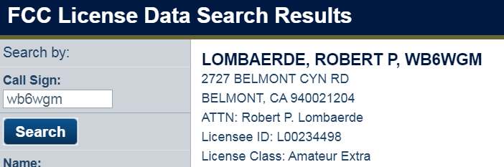
SCARES repeater nuances-3
Don’t transmit during RB activation
During nets when RB is ON, 2m input will trigger a triple beep
Don’t announce you will be out of town

Slide 24
Simplex Repeaters
“Simplex Repeater” is NOT a repeater
Not simultaneous transmission of voice
Acts like a parrot – repeating input
Should be monitored/controlled by user
Useful for extending range of comms for a group
Not suitable for 24/7 operation
Can be used outside of repeater bands

Slide 25
Connecting to the world digitally via VOIP, internet
D-Star – Icom, Kenwood
Fusion, Yaesu
IRLC/ECHOlink
DMR, Digital Mobile Radio
APCO P25
Can SCARES repeater use VOIP/internet?
No – no internet and no phone line

Slide 26
Wires (Yaesu)
Yaesu DTMF encode option
Allows access to repeater connected to internet for world wide access
Sends out DTMF code to open gateway
Blanks out speech during first part of transmission. You only hear “---WGM”
Unfortunately easily turned ON – causing loss of voice initially

Slide 27
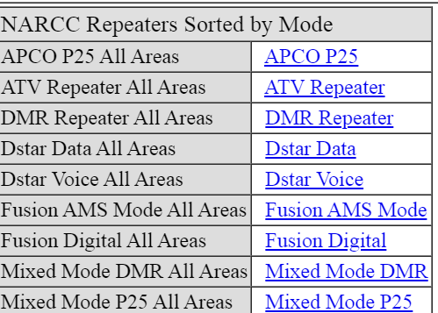
NARCC
Northern Amateur Relay Council of California

Slide 28
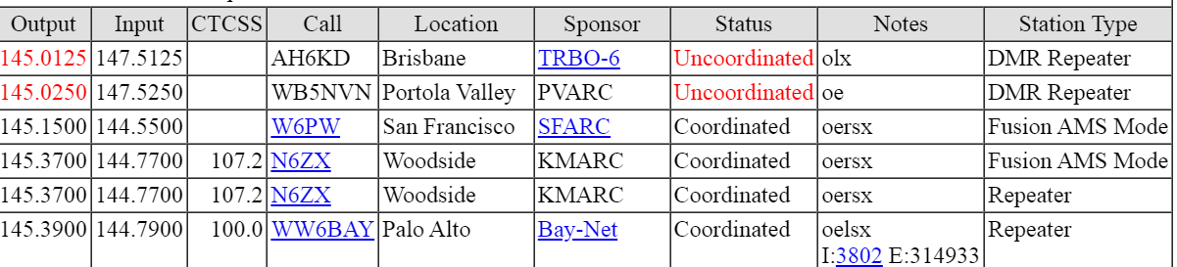
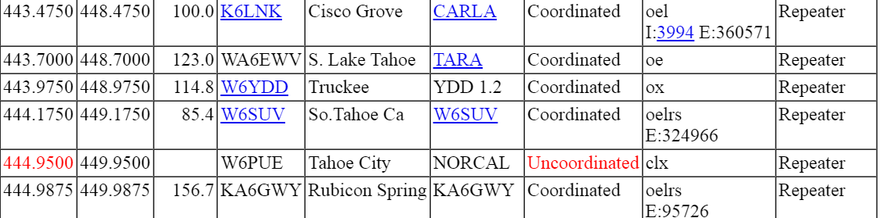
NARCC (cont.) showing open/closed and Fusion,DMR

Slide 29
Simplex
SCARES “in the old days, before the repeater” Nets were 2m simplex
With height, long line-of-sight distances are possible - SOTA
Relays were used so all could check-in
Locally omni antennas worked well, for distance directional antenna are better
W6VOM, Neil in Dublin, K6VP, Dan, SJ

Slide 30
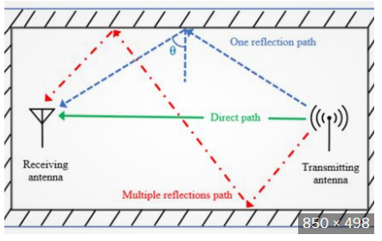
Multi-path - reflections

Slide 31
Multipath problems
Multiple delayed signals received
Caused by reflections due to – hills, walls, buildings, atmosphere, etc
Causes distortion in receiver
Cured by receiving best signal with directional antenna

Slide 32
Repeaters, Simplex, etc.
Questions ??

