Slide 1
Alternate Amateur Frequencies
Why?
What?
Features
Robert Lombaerde, WB6WGM
16 October 2025

Slide 2
Why Alternate Frequencies?
If typically used frequencies (2m, 70cm) are unavailable, occupied, repeaters down Possibilities: HF,10,6, 220, UHF
Specific propagation needed LOS, NVIS, distance, local, within buildings
Specialty modes FM, APRS, packet, Winlink, CW, SSB, AM

Slide 3
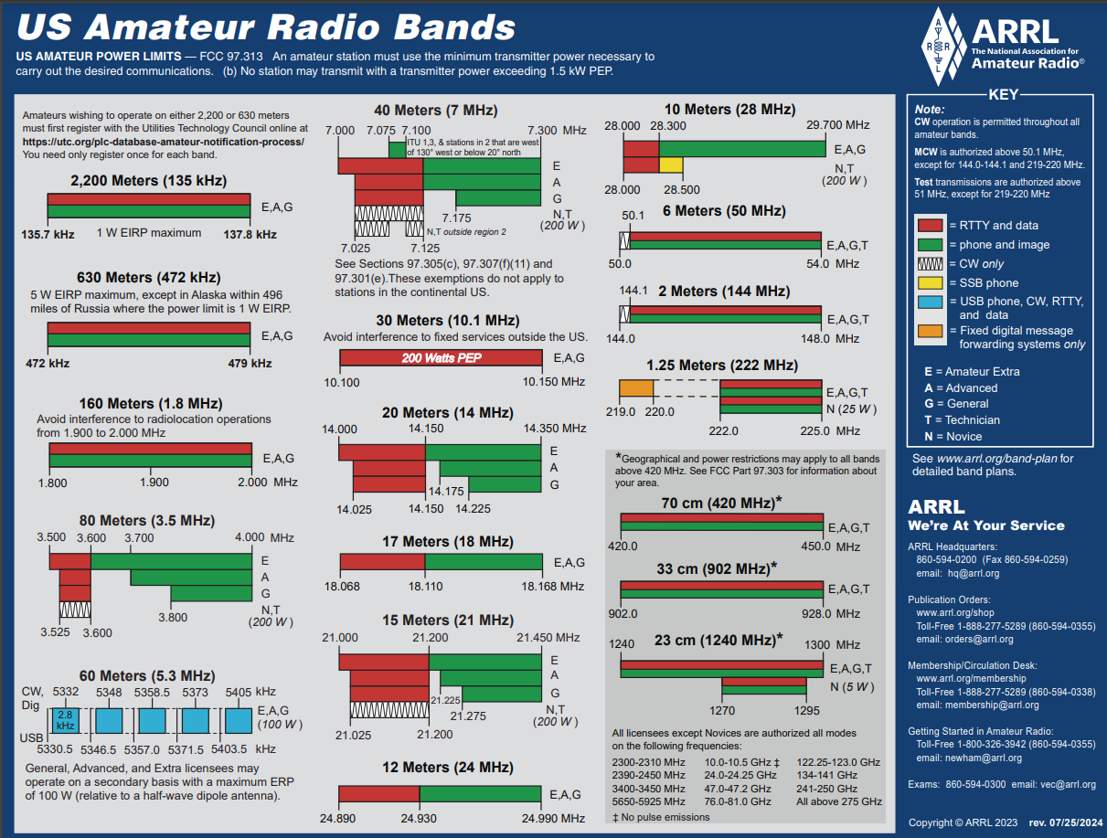
Bands available to Hams ARRL.org

Slide 4
Where can I operate?
License class determines band
License class determines where in band
A licensed ham with privileges in a band may act as a “control operator” for hams without privileges in that band
References: ARRL.org, NARCC.org

Slide 5
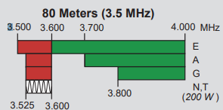
Example:80 m (3.5-4 MHz)

Slide 6
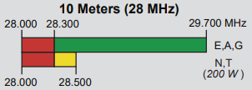
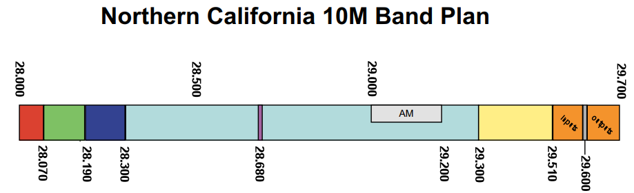
10 m interesting allocations

Slide 7
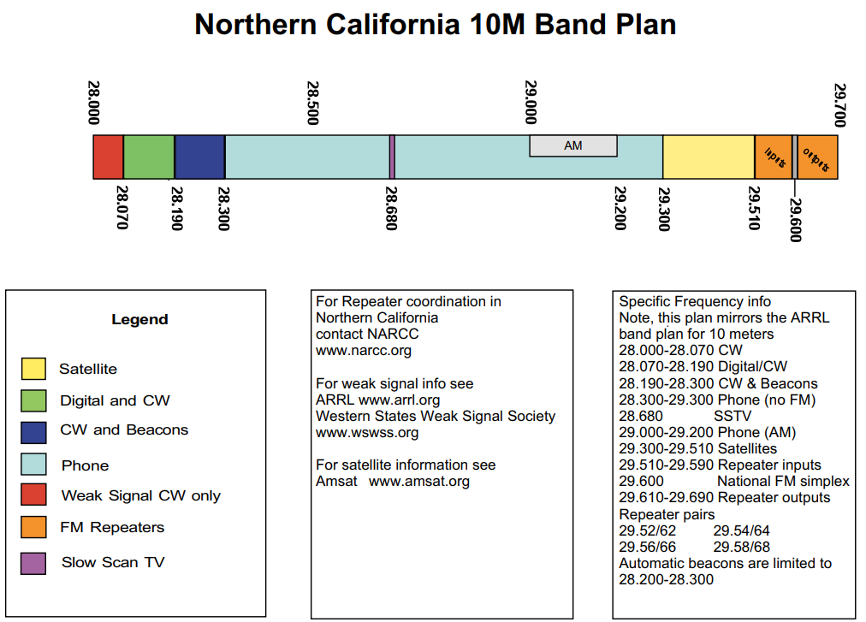
NorCal 10m Band Plan

Slide 8

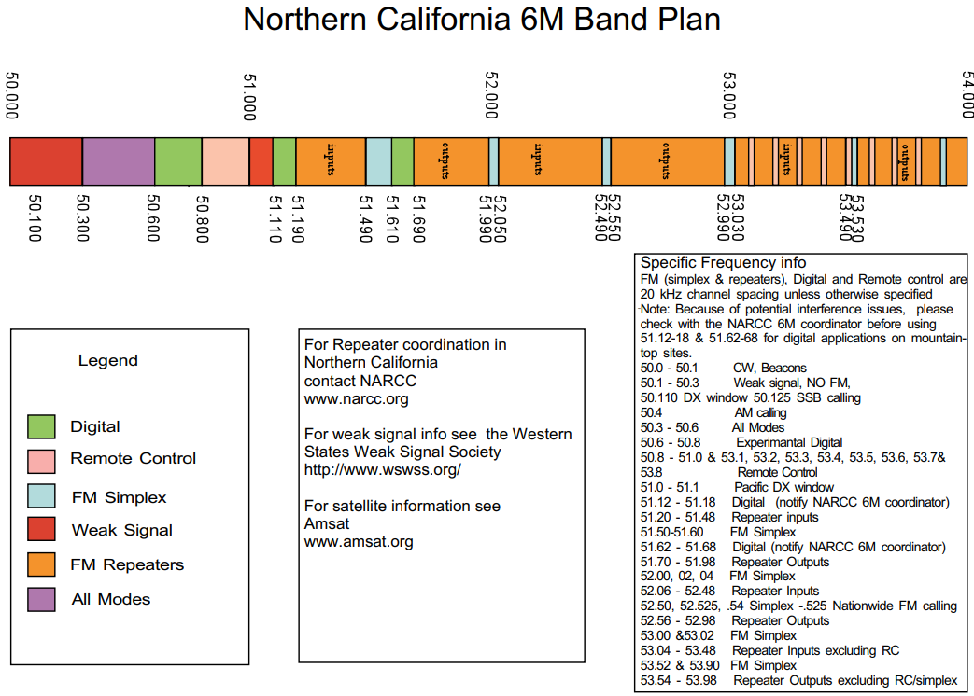
6 m band plan

Slide 9
HF Band Features/Attributes 3.5 to 28 MHz (80-10m)
Large antennas, high power radios (20 to 100W), not exactly hand-held -portable, noisy conditions (80 – 40m)
80-40 m local comms, NVIS
20-15 m DX, continental, winlink
10 m short haul (normally) local ground wave, skip (CB)

Slide 10
HF Band Features/Attributes 3.5 to 28 MHz (80-10m)
HF 80-40 m (3.5 – 7.3 MHz)
NVIS 400 mi radius, 80 night/40 day, noisy, ionosphere dependent, MUF, long wire antennas, 40 m foreign broadcast interference.
HF 20-10 m (14.0 – 29.7 MHz)
DX with low angle shorter antennas, continental comms ionosphere dependent, above 20m more sun spot cycle dependent, POTA, SOTA

Slide 11
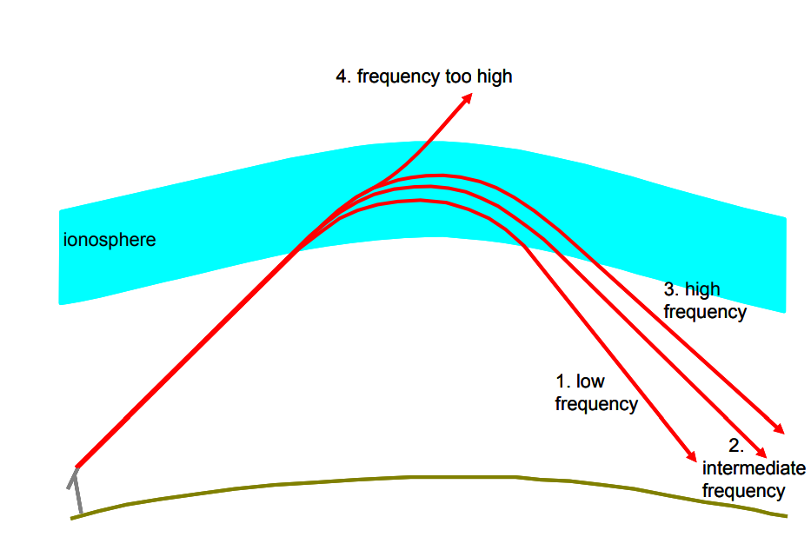
Maximum Usable Frequency Frequency & Ionosphere

Slide 12
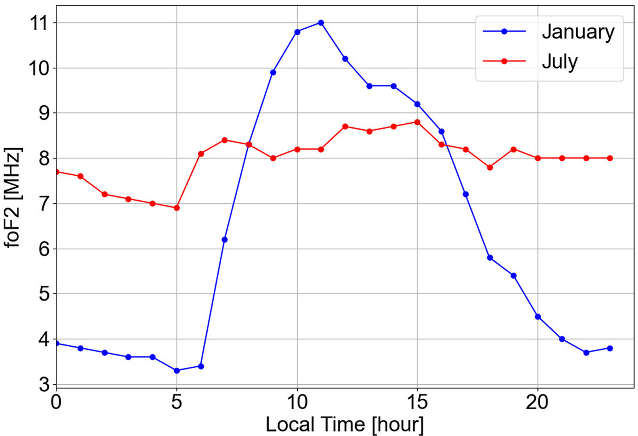
Maximum Usable Frequency MUF over Time

Slide 13
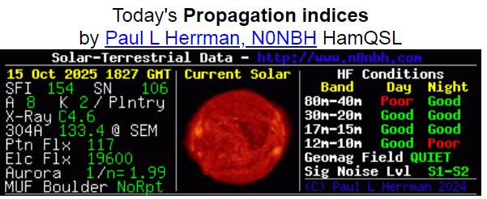
HF Band Conditions

Slide 14
VHF-UHF Features/Attributes
VHF 6-2m (50 – 148 MHz) LOS comms, simplex, repeaters, lower power radios, HTs, emcoms, speciality modes – APRS, Packet, DFing, small antennas, inexpensive equipment
UHF 220MHz-70cm (220 – 450 MHz) LOS comms, mostly repeaters, low power, internet connections, smaller antennas, inexpensive equipment

Slide 15
6m, VHF, UHF and Higher Features/Attributes
Small antennas, portable radios, battery operated, hand held, multi-channel, multi-band, convenient. inexpensive radios, SOTA, POTA
limited range, local comms, LOS, more loss at higher frequencies
Extend range: SSB vs FM, gain antennas, repeaters, linked repeaters connected to internet,

Slide 16
HF Antennas How Long is LONG
Antennas based on ½ wavelength dipole
One Wavelength= speed of light/frequency
or 300,000,000(m/s)/Frequency(Hz or c/s)
300,000,000 (m/s)/150,000,000 (Hz)=2 m/c 2m/cycle or 78 inches/cycle a half wave 150 MHz antenna is 39 inches long
A 2m ¼ wave length vertical is 39/2 ~ 19 in

Slide 17
Calculating the length of 80 meter ½ wave dipole
300,000,000 (m/s)/ 3.5 MHz = 85.71 m (1 wavelength)
½ wave dipole is then 85/2 = 42.5m
In feet: 139.4 ft
Will a 139.4 ft dipole fit in your garden?
Will a ¼ wave vertical of 69.7ft ?
Other HF bands are multiples – do the math ! 40m~66 ft, 20 m~33 ft

Slide 18
Conclusion (1)
Tech operators can operate on non-privileged frequencies monitored by control operators with band privileges
Long distance contacts are possible on HF bands, Ionosphere dependent
NVIS operation on 80/40 m may allow comms to local inaccessible areas

Slide 19
Conclusion (2)
Different modes than FM can increase range of simplex transmissions – SSB, CW – gain antennas can help also
Specialty programs can provide increased capability and agency help APRS- tracking Winlink – distance email Packet – radio messaging DFing – interference hunting

Slide 20
Conclusion (3)
Low HF bands require large antennas
Comprise (shorter loaded) HF antennas are not as efficient
VHF/UHF local comms more reliable than HF and cheaper to implement

Slide 21
The End
Questions?

