Slide 1
PRO Words, Brevity,
Best Practices
August 20 2026
Ryan Herbst N6AMQ
Robert Lombaerde WB6WGM

Slide 2
Getting the Message Across
Clear - Unambigous
Brief – Compose before TX
Concise – Who, What, When
Use PRO words

Slide 3
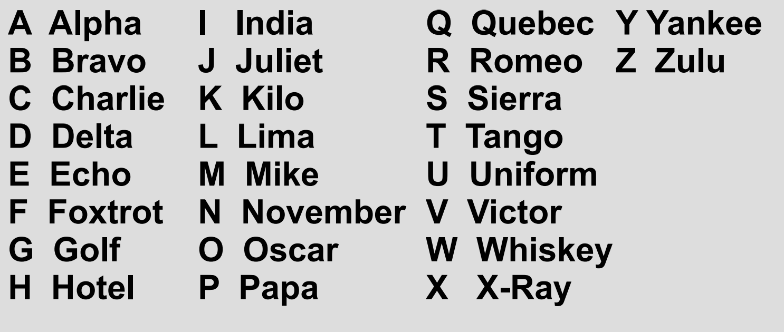
Phonetic Alphabet

Slide 4
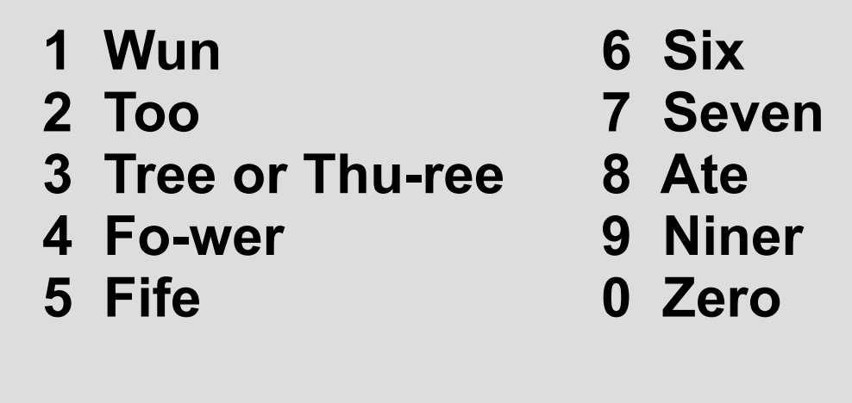
Numbers

Slide 5
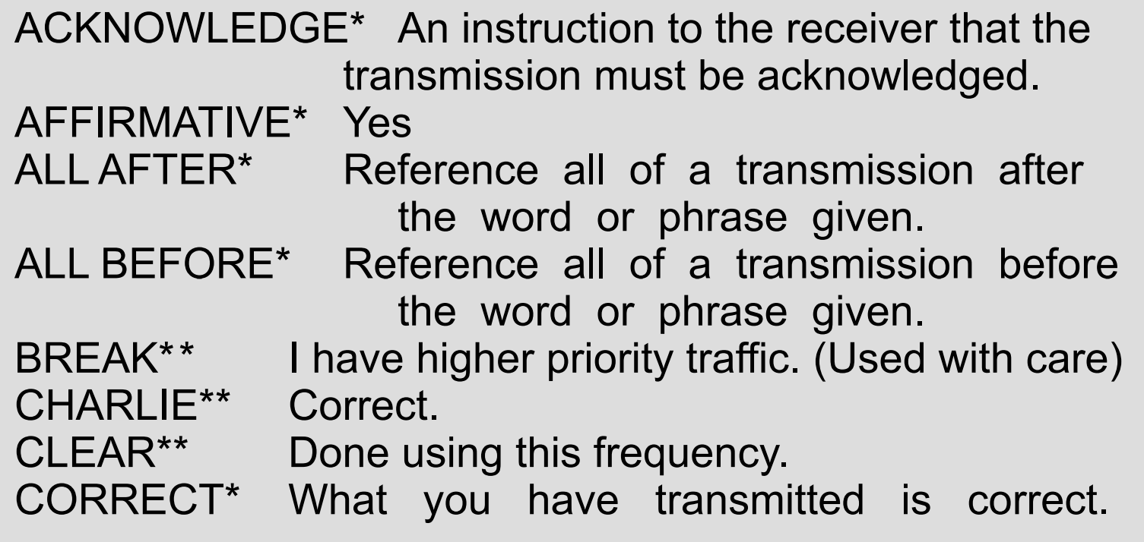
Pro words

Slide 6
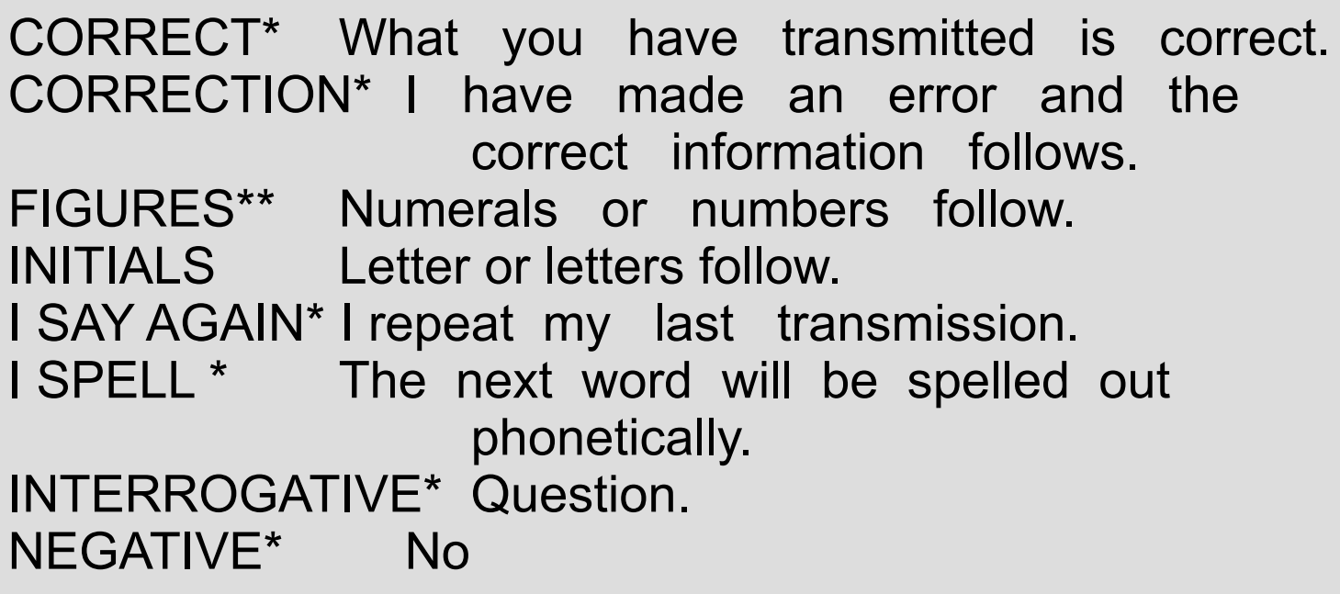
Pro words

Slide 7
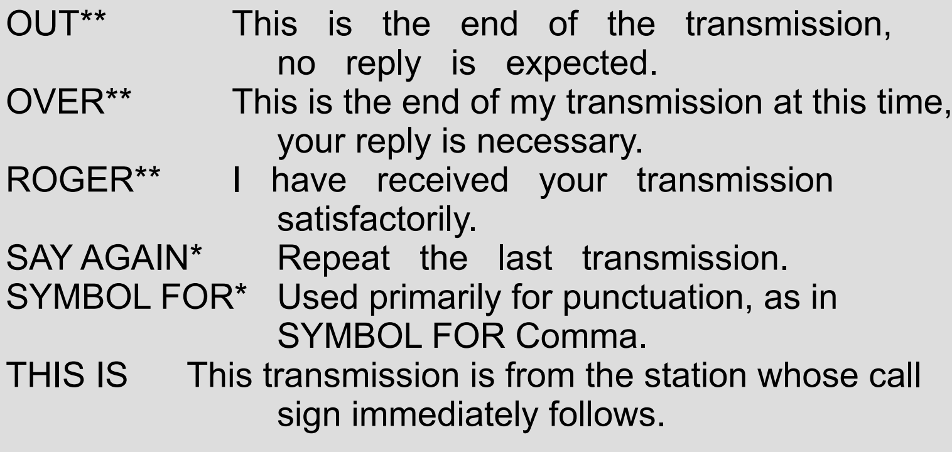
Pro words

Slide 8
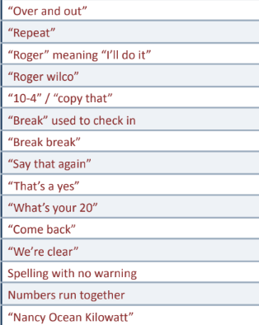
What should you have said ?

Slide 9
Net Control
Read the script and follow it
Acknowledge check-ins
ID every 10 minutes and end of net
Include breaks in TX for priority traffic or Relay
Don’t key-up on top of another user, allow repeater controller to reset (90 sec timeout)
Get the correct Call Signs for guests (relay)
Allow stations to end with their call sign

Slide 10
Tactical Call Signs
Typically identifies station location
May be used by several operators at location
Tactical name stays same with shift change
Helps net control operator identify station
Say FCC callsign at end of transmission

Slide 11
Brevity
Think of what you want to say –
long transmissions don’t allow stations to break in with priority traffic.
Use PROwords
Don’t over explain answers to questions
Keep it simple

Slide 12
Questions
?

