Slide 1


Radio and Antenna Systems
Ryan Herbst, N6AMQ
Robert (Bob) Lombaerde, WB6WGM
17 September 2026
Notes:
South County ARES presentation, 15 October 2020.

Slide 2
Presentation Outline (needs update)
Wavelength, resonance, and SWR
HTs and attached antennas
Mobile operation
Home base stations
Q & A

Slide 3
How long is an RF cycle ?
Speed of light 299,792,458 meters/sec
Frequency is 146.445 MHz (Mcycles/sec)
Length 1 cycle = m/s / c/s = meters/cycle

Slide 4
Let’s simplify the math
Speed of light = 300,000,000 meters/sec
Frequency is 150 MHz (Mcycles/sec)
Length 1 cycle = m/s / c/s = meters/cycle
300,000,000 / 150,000,000 = 2 meters
2m @ 146.445Mhz = 80.5958 inches = length of 1 cycle

Slide 5
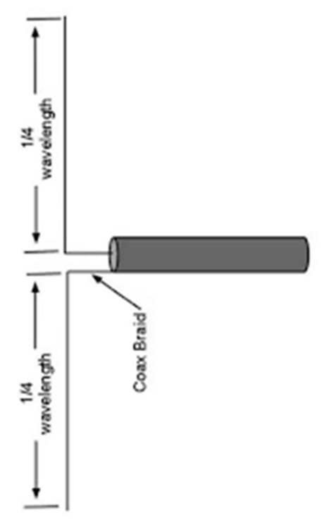
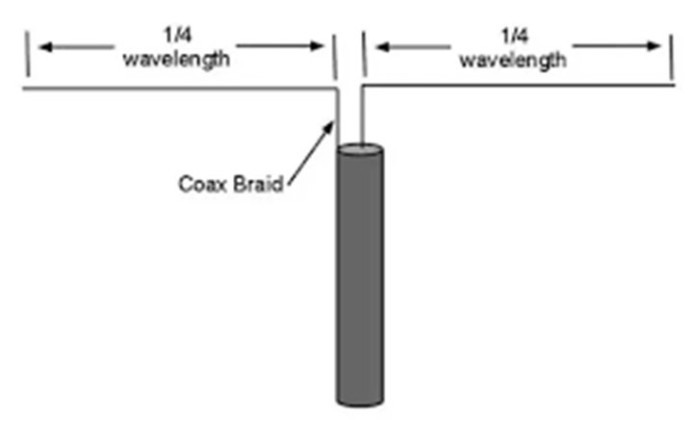
Half wave dipole, the standard resonant antenna
Half wave at 2 meters is ~40 inches
Quarter wave at 2 meters is ~20 inches

Slide 6
What antenna resonance really means
Every antenna has one length that matches one frequency, the way a tuning fork rings at one note
Push a swing in rhythm and it climbs with no extra effort. A resonant antenna accepts power the same easy way
Right length and the power goes out. Wrong length and the radio and the antenna fight each other
The stubby antenna on an HT is a deliberate compromise. Coils inside make it act longer, and you pay in efficiency
One band, three lengths
Too short
Resonant
Too long
Longer is not automatically better. Only the resonant length is an easy load for the radio.
Notes:
Resonance in plain terms: one length, one frequency. The swing analogy usually lands better than the tuning fork for a mixed audience. Tie back to the 2 meter wavelength math earlier in the deck.

Slide 7
SWR: is your power actually getting out?
SWR tells you how much of your transmit power the antenna accepts. What it will not accept comes back down the coax
A modern radio protects itself by turning its power down, so bad SWR shows up as people simply not hearing you
Common causes: an antenna cut for the wrong band, a loose or corroded connector, water in the coax, a mag mount on a roof that is not metal (see later slides)
Check it with an SWR meter or antenna analyzer before the event, not during it
SWR | Power that comes back | What to do about it
1.0 : 1 | none | Perfect, and almost never seen in the real world
1.5 : 1 | about 4% | Very good. Nothing to fix
2.0 : 1 | about 11% | Fine for voice on 2 meters and 70 cm
3.0 : 1 | about 25% | Check the antenna, the coax and the connectors
5.0 : 1 | about 44% | Stop transmitting and find the fault
Notes:
Keep it practical. The audience does not need the formula, just the sense that 1.5 is great, 2 is fine, 3 means go looking for a problem, and anything higher means stop.

Slide 8
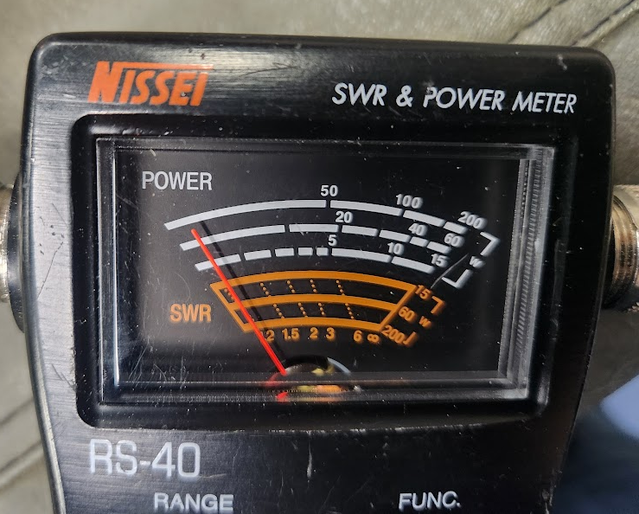
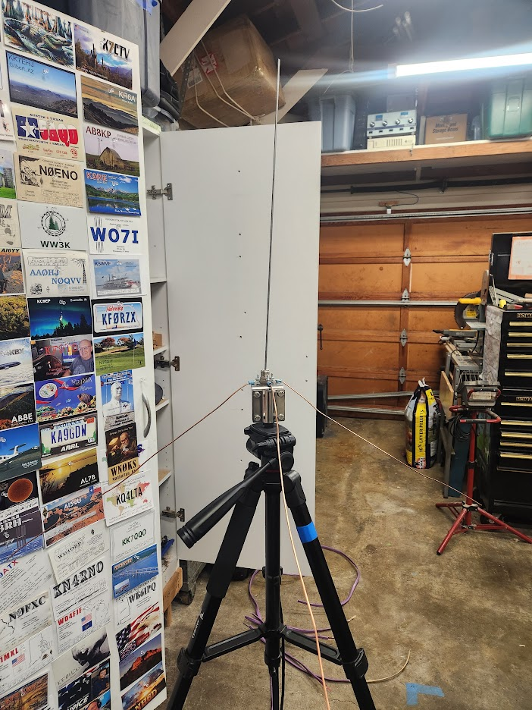
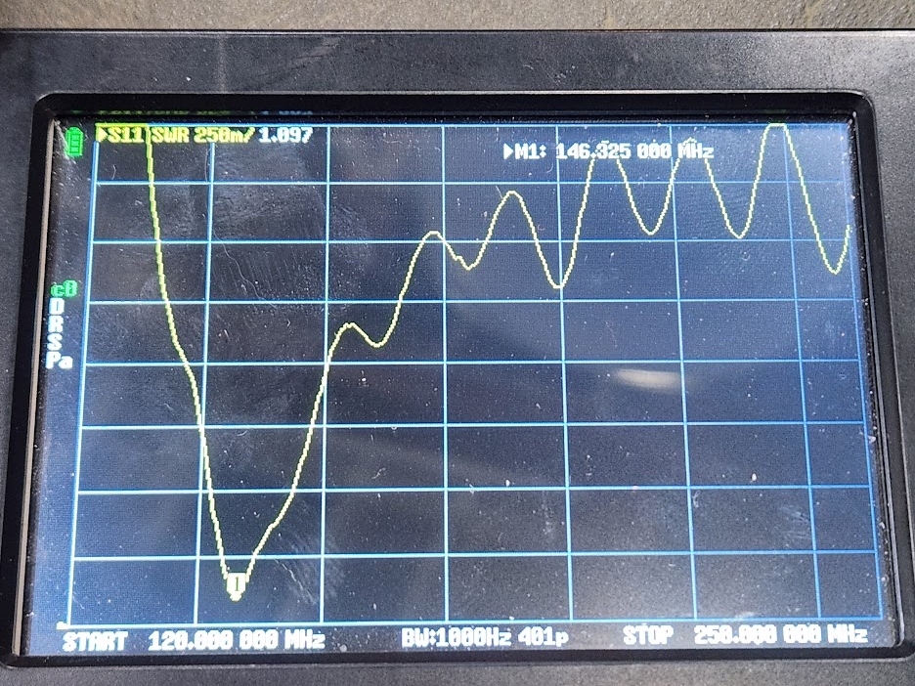
SWR For 2M Resonant Antenna
Notes:
Keep it practical. The audience does not need the formula, just the sense that 1.5 is great, 2 is fine, 3 means go looking for a problem, and anything higher means stop.

Slide 9
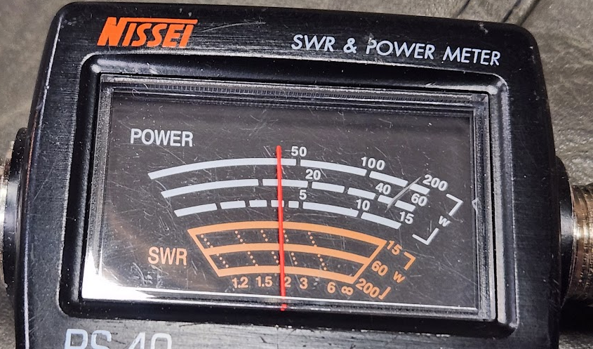
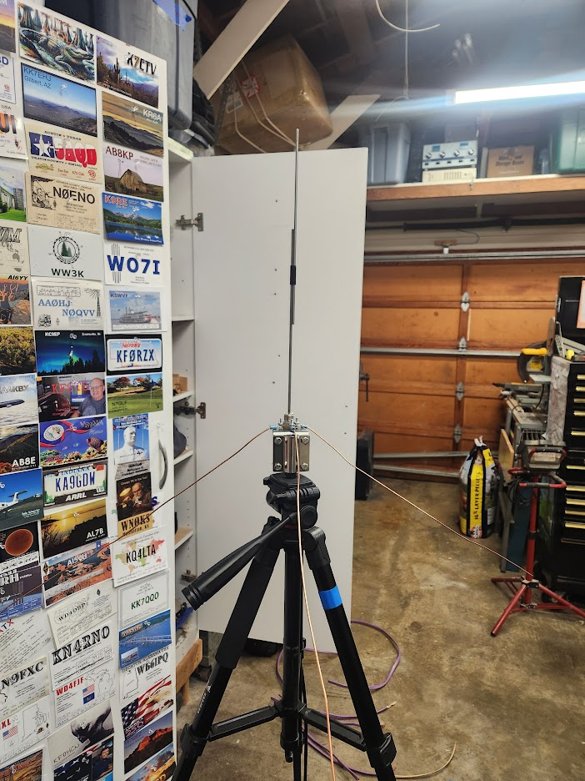
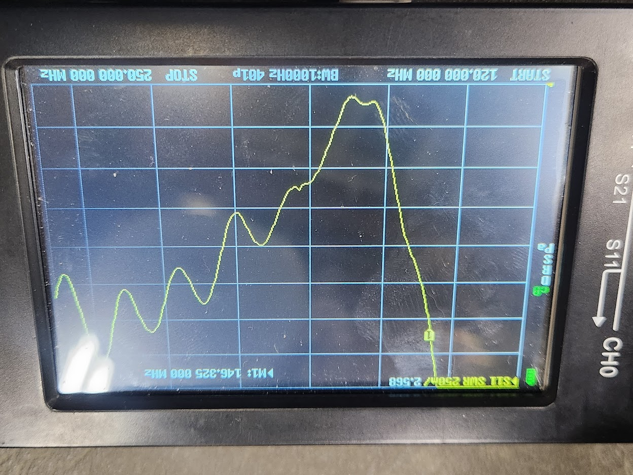
SWR For 2M Non-Resonant Antenna
Notes:
Keep it practical. The audience does not need the formula, just the sense that 1.5 is great, 2 is fine, 3 means go looking for a problem, and anything higher means stop.

Slide 10
Taller is better?
Is 5 watts out, 5 watts out?
Quarter wave antennas are the baseline
5/8 and half-wave gain antennas will focus more energy to the horizon than upward – achieving relative gain

Slide 11
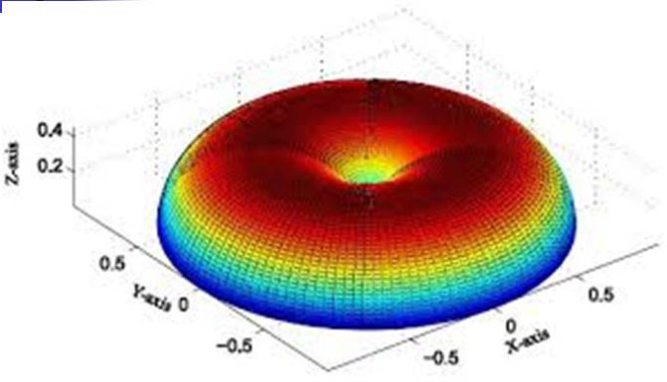
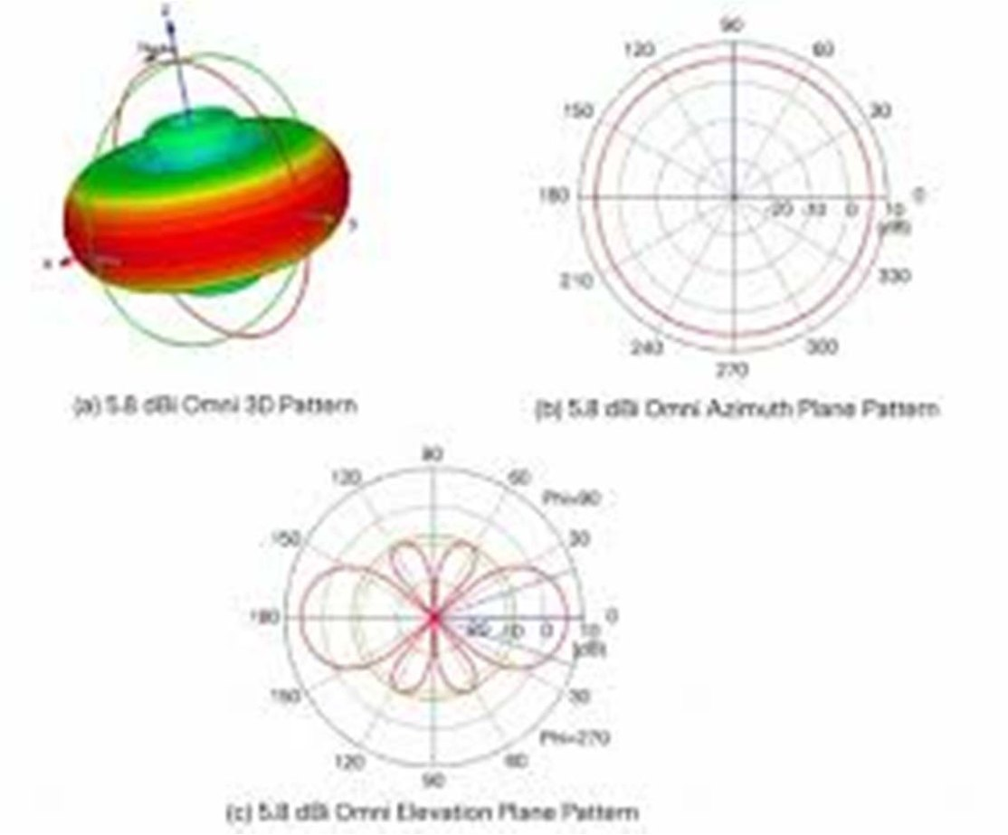
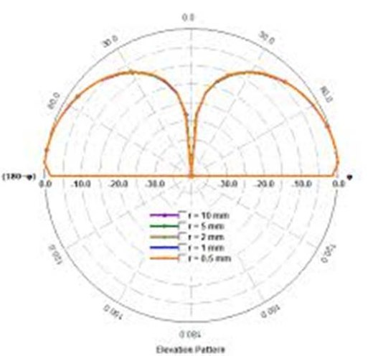
¼ vs 5/8 antenna pattern (I may remove)

Slide 12
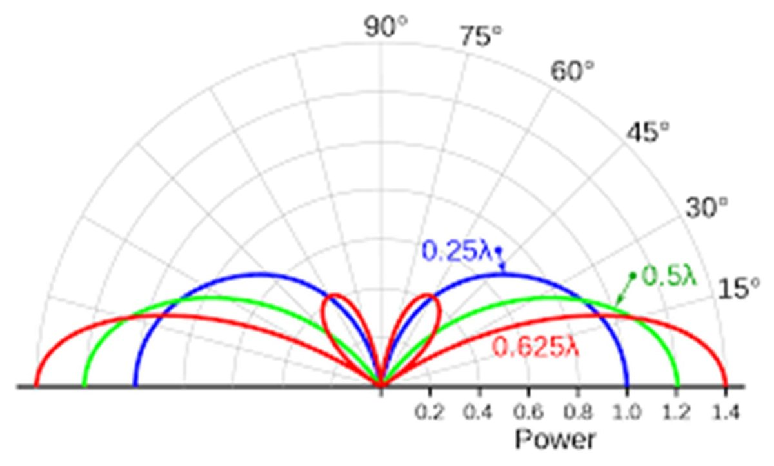
¼ vs ½ vs 5/8 antennas

Slide 13
Why ¼, ½ and 5/8 are all resonant
Resonant means the radio sees an easy, near 50 ohm load. All three get there. They just take different routes.
¼ wave
½ wave
5/8 wave
about 20 inches on 2 meters
about 40 inches on 2 meters
about 48 inches on 2 meters
Only half an antenna. The metal roof mirrors it and supplies the other half
No ground plane, no resonance
Lands close enough to 50 ohms to feed directly
A complete antenna. It borrows nothing from the vehicle
Works on a fiberglass roof, a tripod, or in your hand
Fed at the end, so a matching section in the base does the 50 ohm job
Longer than resonant on purpose, so on its own it is not a match
The coil in the base cancels that out and restores resonance
Still needs a ground plane
The extra length does not make more watts. It aims more of them at the horizon instead of the sky: roughly 3 dB from a 5/8 over a ¼ wave, on a good ground plane. A low SWR on its own does not prove an antenna is radiating, since a dummy load is a perfect match and radiates nothing.
Notes:
The point to land: a quarter wave is resonant because the ground plane completes it, a half wave is resonant on its own and needs a matching section only because it is end fed, and a 5/8 is deliberately too long and is pulled back to resonance by the base coil. That coil is what they saw inside the Comet GP-15 earlier. Gain figures from manufacturers tend to be optimistic and assume a good ground plane.

Slide 14
¼ vs ½ vs 5/8
Ground plane needed for ¼ and 5/8
¼ is optimized for one band. A 2 m quarter wave does work on 70 cm as a three quarter wave, with a higher angle pattern
½ easy dual band 2m and 70 cm with reasonable length ~39 inches
No practical dual band 5/8 designs (single element with coil)
2m 5/8 will tune on 6m, length ~48”

Slide 15
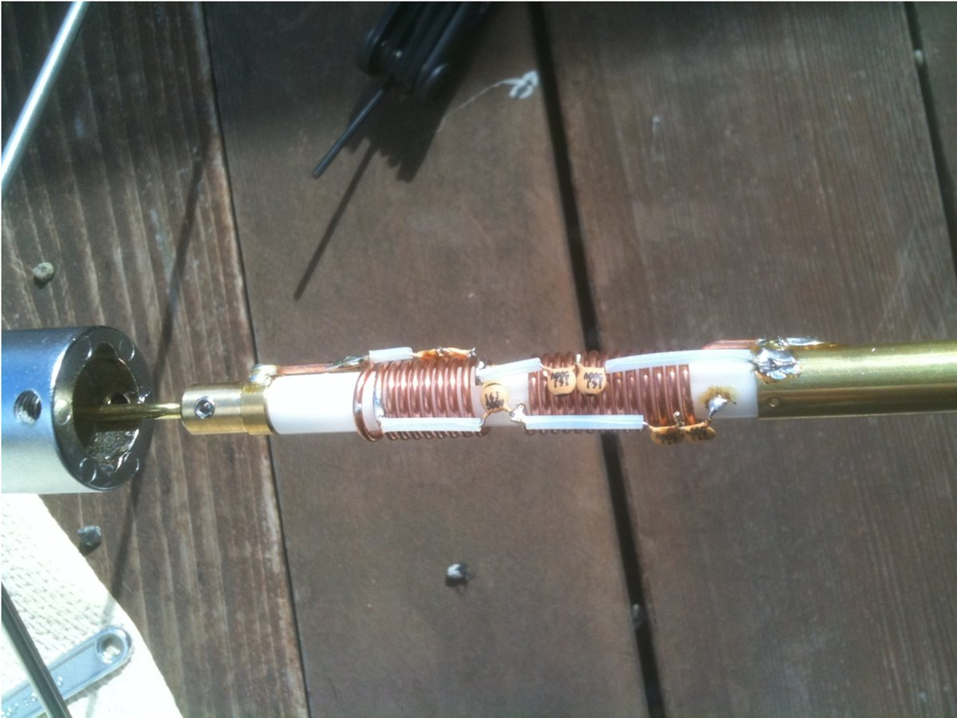
What a loading coil looks like
Comet GP-15 internals

Slide 16
Baofeng antenna possibilities
The Baofeng OEM antenna is about 6 inches
A quarter wave at 2m is ~ 20 inches
There is a compromise between convenience and efficiency
Quarter wave length at 70 cm = 6.5 inches
Internal components also let the same antenna work on 70 cm
So the stock antenna is a real quarter wave on 70 cm and badly short on 2 meters. It is far more efficient on 70 cm.

Slide 17
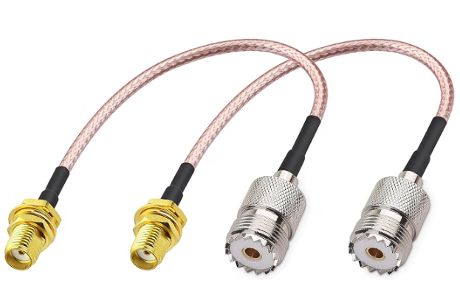
Dual band antenna options on the Baofeng HT
The radio has an SMA male port, so the antenna must be SMA female. This is backwards from most ham HTs
Do not buy anything marked RP-SMA. It threads on fine and gives you bad SWR
An adapter is an option for conversion
  Handheld Antenna Cable for Wouxun Baofeng Quasheng Linton - 2 for $7 on Amazon
Possible direct screw-in antennas:
Nagoya | NA-771 | $15 to $20
Diamond | SRJ77CA | $30 to $35
Comet | SMA-24J | $30

Slide 18
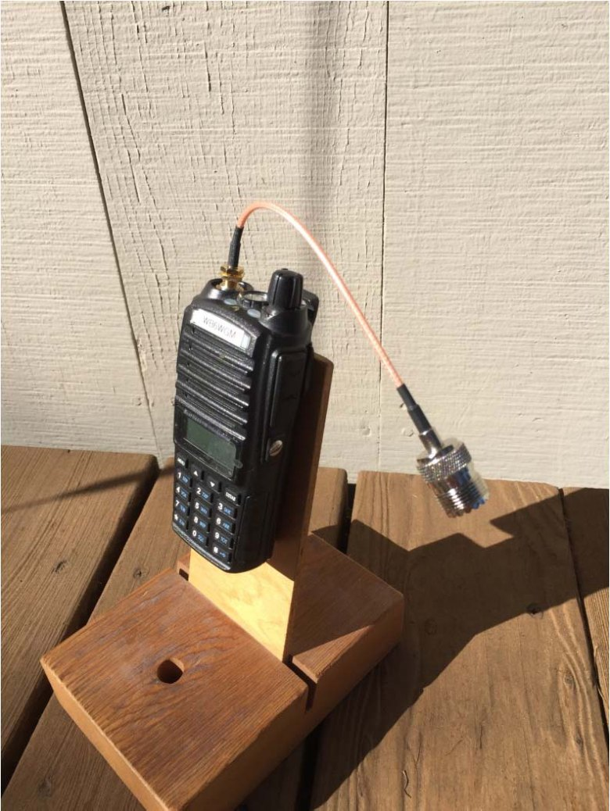
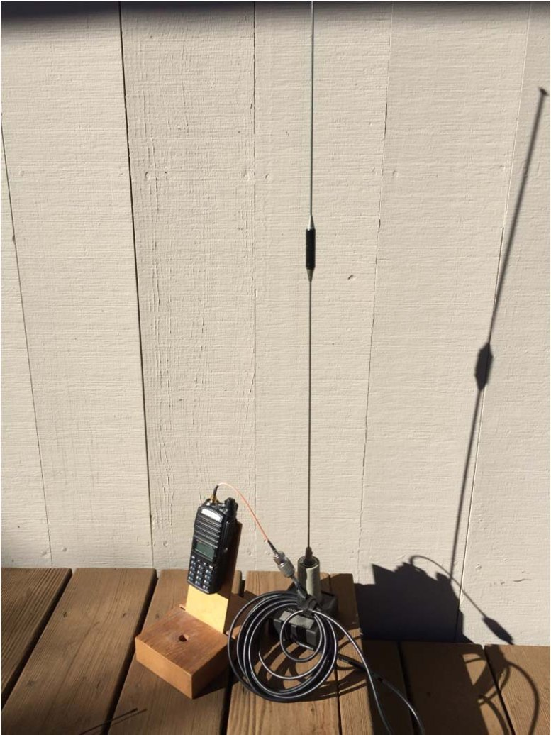
Interface HT to cable

Slide 19
Mobile Radio system
Instead of HT install a mobile radio
Dual band radio recommended: 2/70
Use same vehicle antennas as with HT
Make sure power handling of antenna is adequate
12 Volts supplied by vehicle (be sure to use a fuse)
More power, better range, more reliable comms, install securely

Slide 20
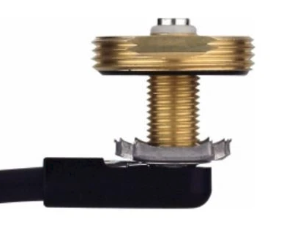
Let’s go mobile with the HT
NC in Redwood City PD can hear a 5 Watt HT on 2 meters using a mag-mount antenna
Antenna installation: permanent or temporary? Drill a hole, attach mount, use mag-mount
Vehicle acts as ground plane
Mount antenna in middle of the roof
Second option – on the trunk
Interface to HT – may require adapter
Use speaker mike for convenience in vehicle

Slide 21
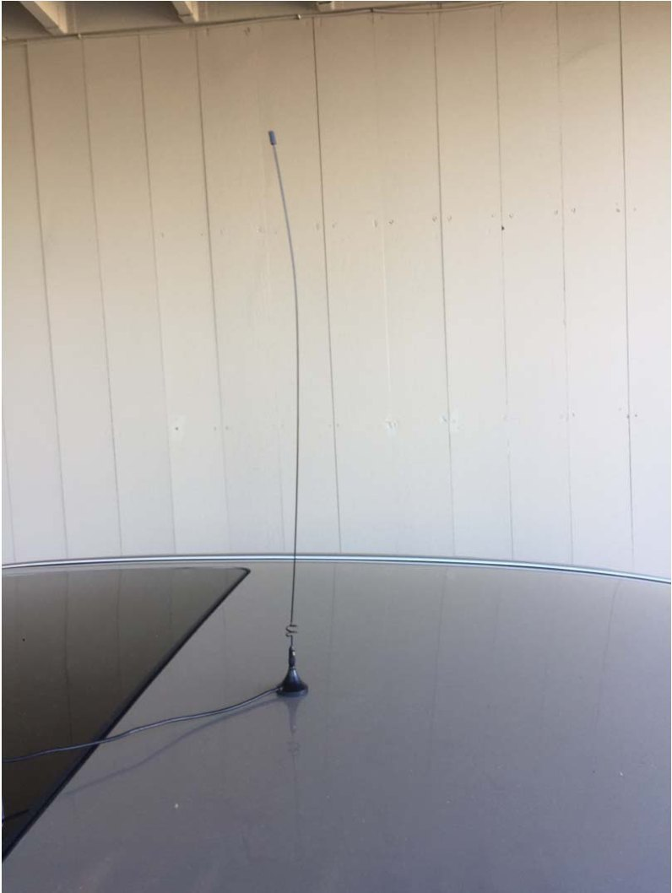
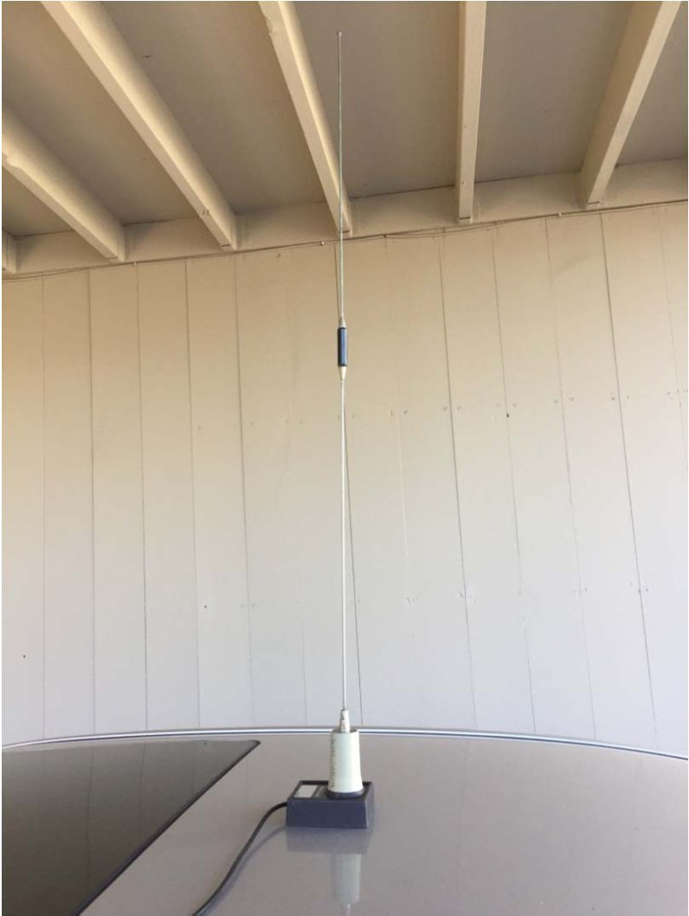
Mobile Antenna Possibilities:
Hershey “Kiss”, Larsen 2/70

Slide 22
Mag mount grounding: what actually matters
A mag mount does not touch bare metal. Paint and the protective pad are in the way, so there is no DC connection to the roof at all. It still works, and here is why.
Why it works anyway
How to get it right
The magnet, the paint and the steel roof form a capacitor. At 2 meters and 70 cm that is a good enough RF path back to the body
A bigger magnet base couples better. Small bargain mounts are the usual culprit
This is not a safety ground and not a DC ground. A meter will read open across it, and that is normal
Center of the roof. A quarter wave on 2 meters wants roughly 20 inches of metal in every direction
Clean the roof and the pad. Grit lifts the magnet, costs you coupling and scratches the paint
Leave the vinyl cover on. Bare metal would couple better but it grinds the paint and starts rust
Size the base to the antenna. A tall 5/8 whip on a small magnet will let go at highway speed
Prove it, do not assume it. Read SWR with the antenna where it will actually live. Good in the middle of the roof and poor on the trunk lid points at the ground plane, not the antenna.
Check the vehicle first. A composite roof or a large glass sunroof means no ground plane at all. An aluminum body gives you a fine ground plane but nothing for a magnet to hold, so you need a lip mount or a through-hole mount.
Notes:
The myth to kill: people assume a mag mount needs metal to metal contact and some of them scrape paint off the roof trying to get it. It does not. The coupling is capacitive, through the paint and the pad, and at VHF and UHF that is plenty. Scraping paint buys a little capacitance and a lot of rust.
If someone asks for numbers: a typical mag mount is on the order of a hundred picofarads against the roof, which is somewhere around ten ohms of reactance at 146 MHz and less at 440. That is small compared to the 50 ohm system, so it disappears into the noise. It also explains why coupling is better on 70 cm than on 2 meters, and why a physically larger base helps.
Trunk lid deserves a mention. It is smaller, it is off center so the pattern goes lopsided, and the lid is bonded to the body only through hinges and a latch, which is a poor RF bond. It works, it is just second best.
Practical closer: if SWR is high, check the ground path before blaming the antenna. Move it to the center of the roof and read it again.

Slide 23
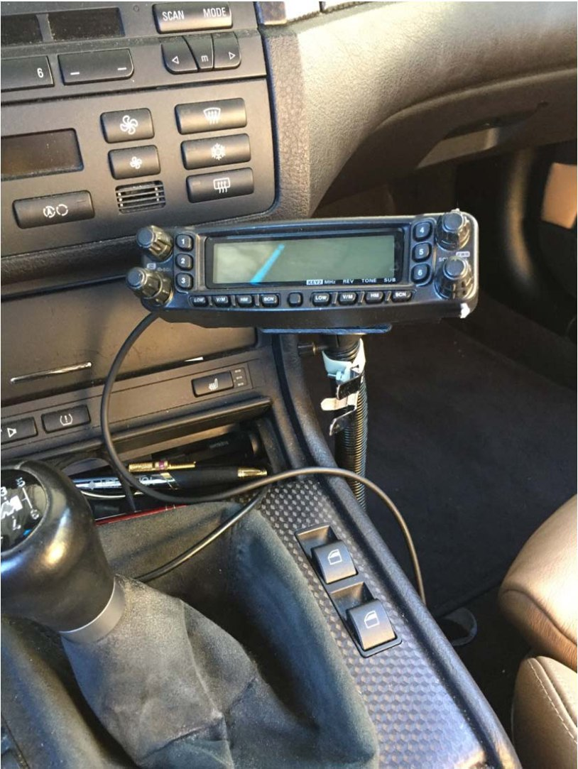
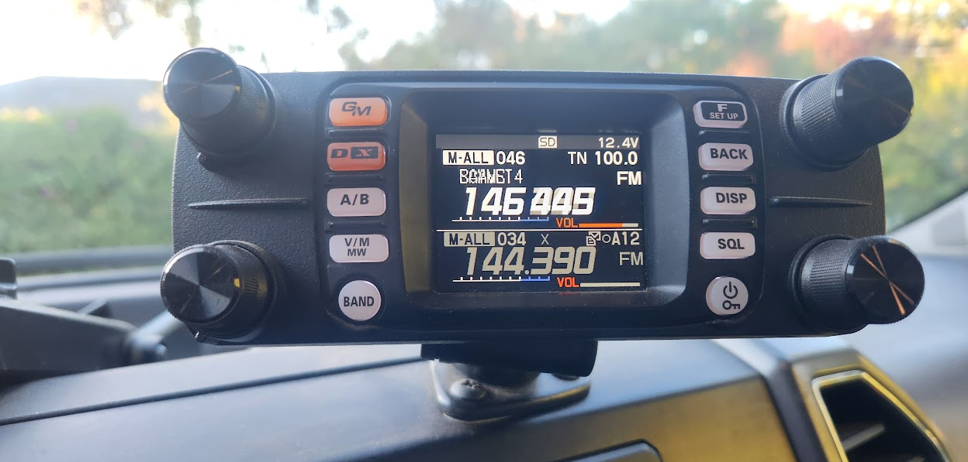
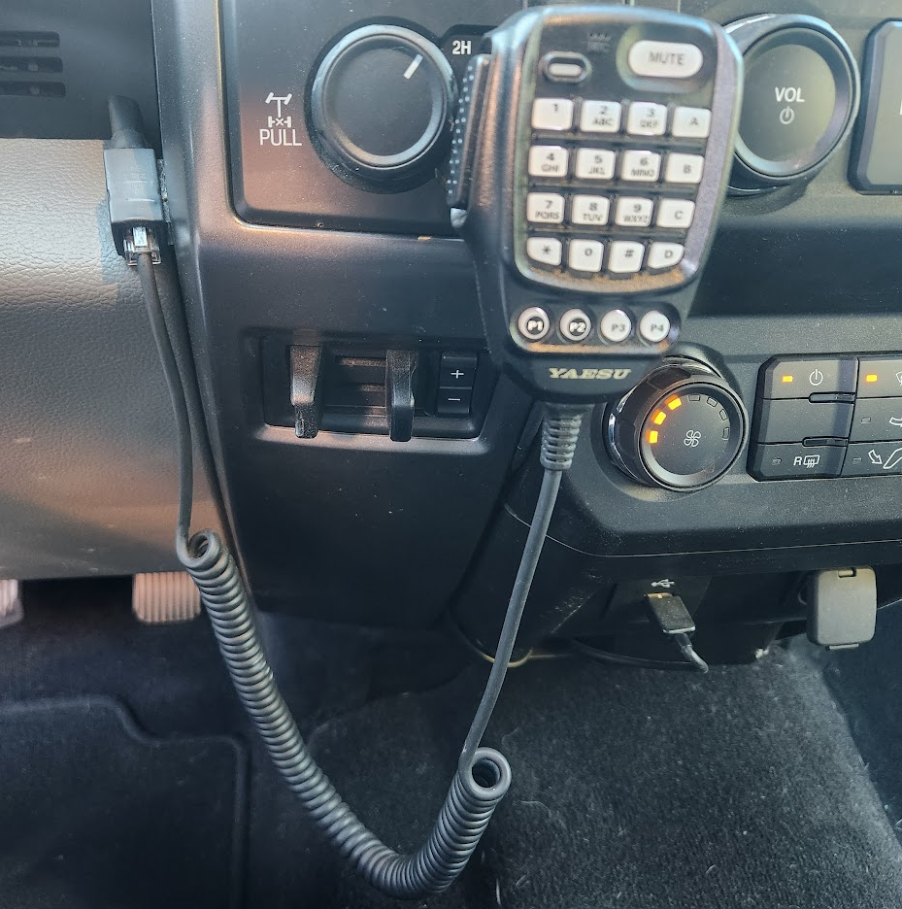
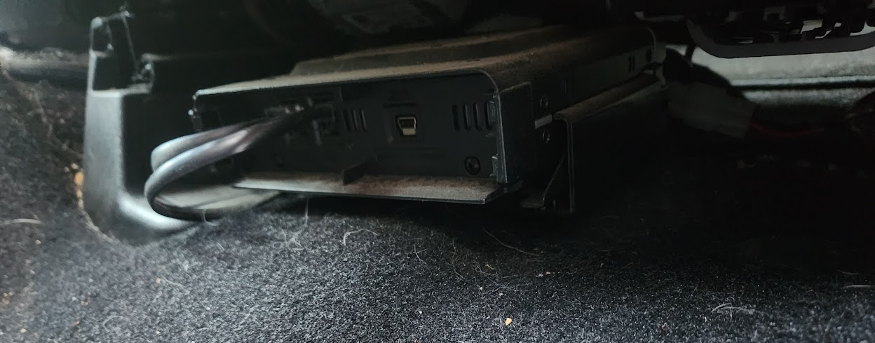
Mobile Remote Dead Installation
FT-8900 Left - FTM-300R Right

Slide 24
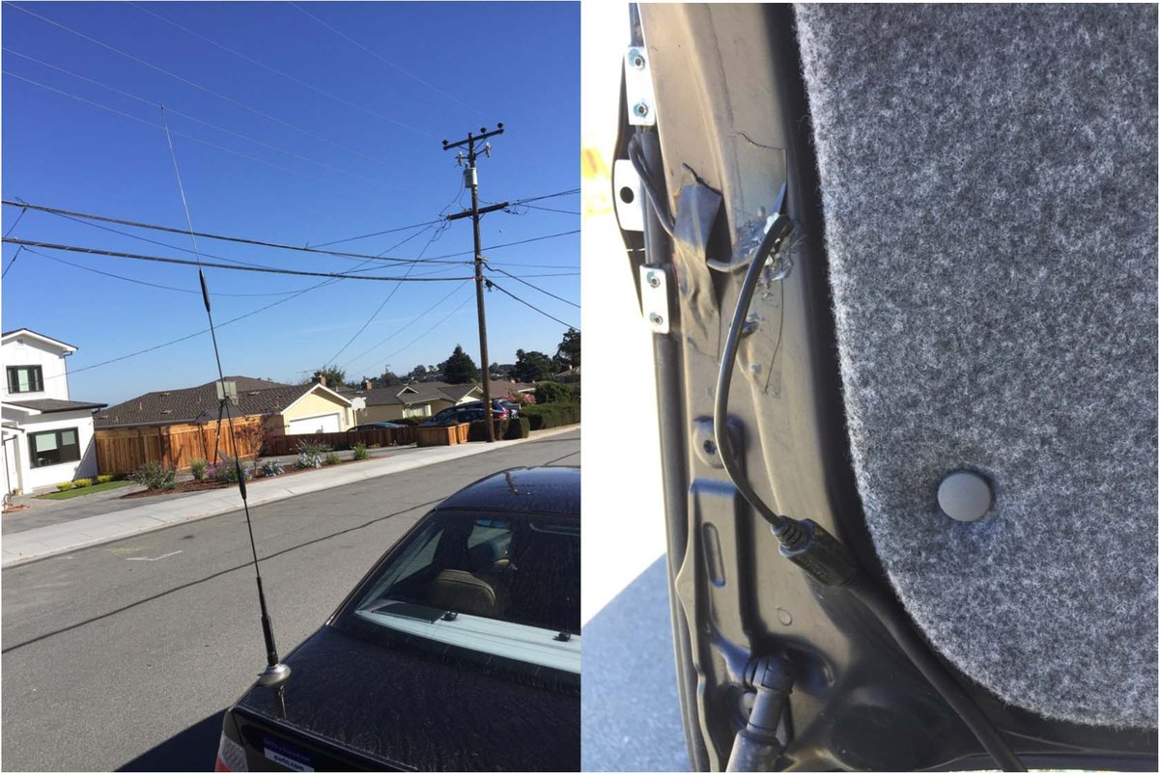
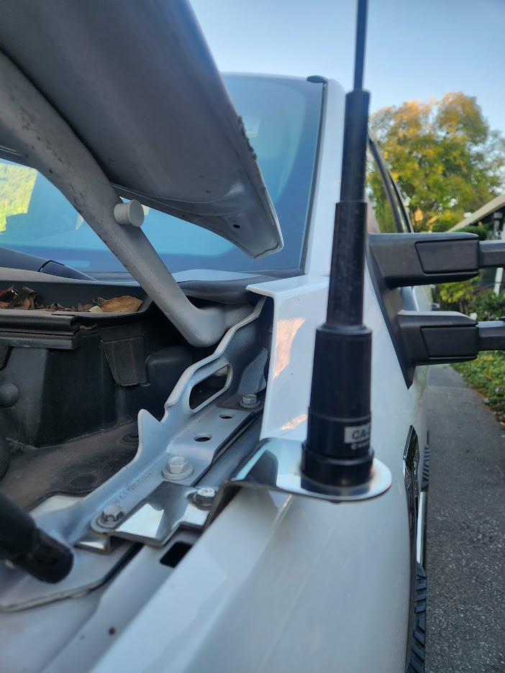
Car Antenna Mounting
6/2/70 Antenna on mount, Note thin cable into trunk
Dual band with mount designed for F250 hood

Slide 25
Home Base Station
A mobile rig is usually used as a base station for its higher power and heat dissipation, longer talk power
12V power supply or battery required
Connect the rig to an external antenna on the roof
A mag-mount on a metal cabinet works too, check how well it works inside

Slide 26
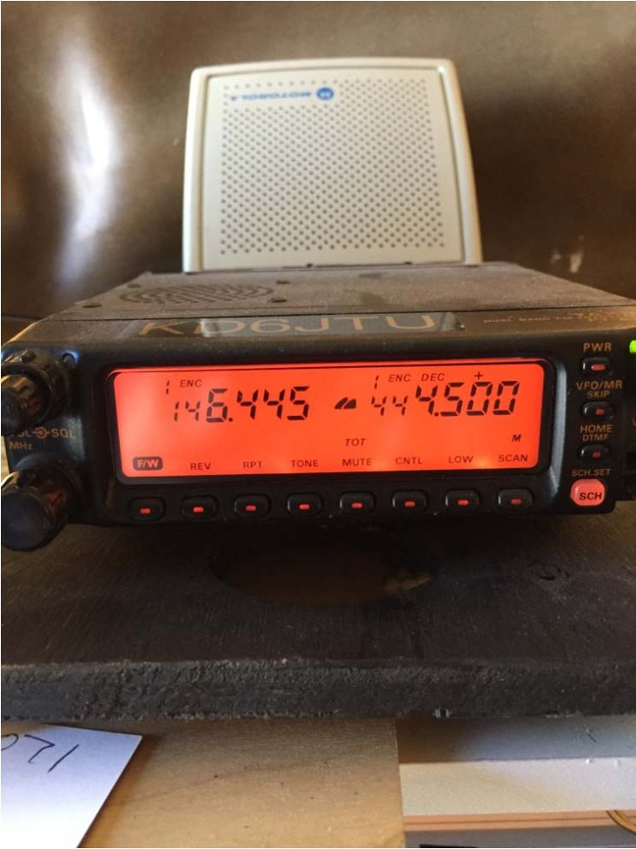
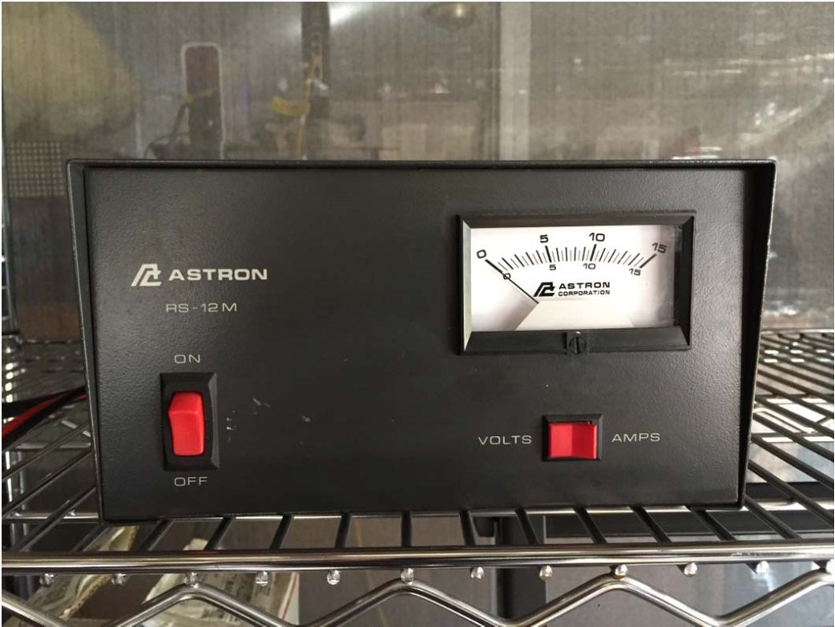
Yaesu FT-8100 dual band and 12V Power Supply

Slide 27
Base dual band antennas
Diamond X50A 2/70 5.6 ft
Comet GP-3 2/70 5.9 ft
Mount antenna high, with no obstructions
Use low loss quality coax cable
Buy cable with connectors installed

Slide 28
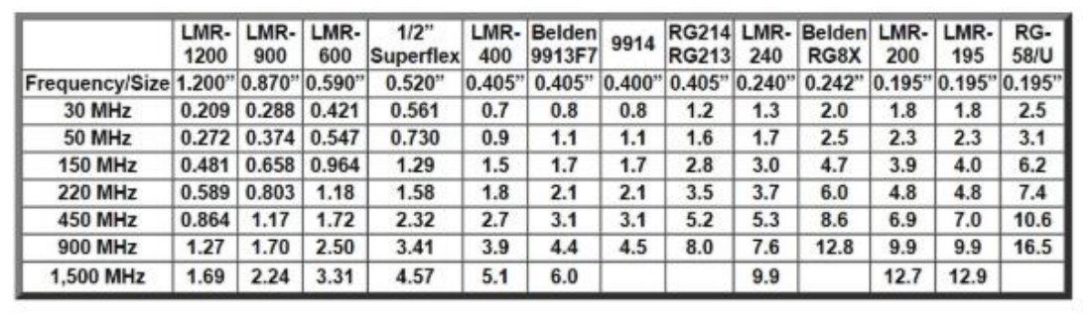
Coax loss at 100 ft

Slide 29
External Antennas
Waterproof connections with tape, wrap bottom up, so layered tape acts like roof shingles shedding water
Provide service loops and drip loops
Provide lightning protection, DC grounding

Slide 30
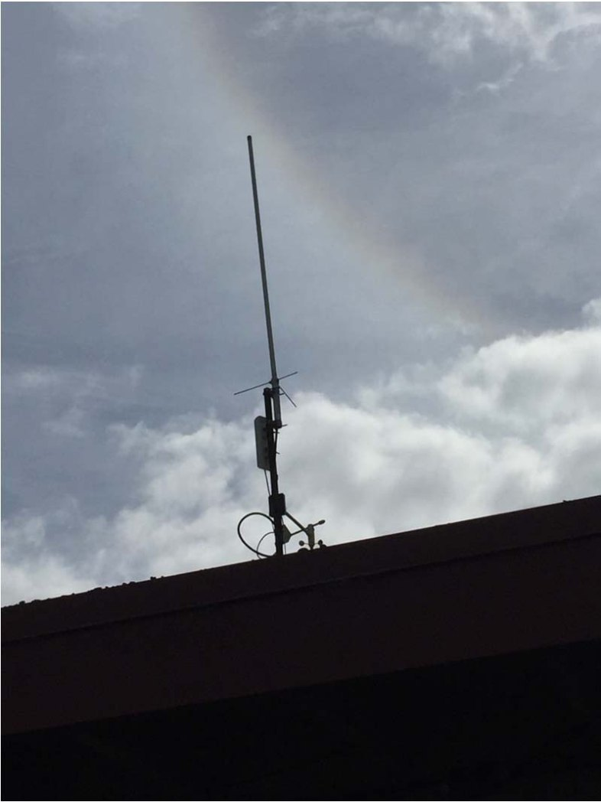
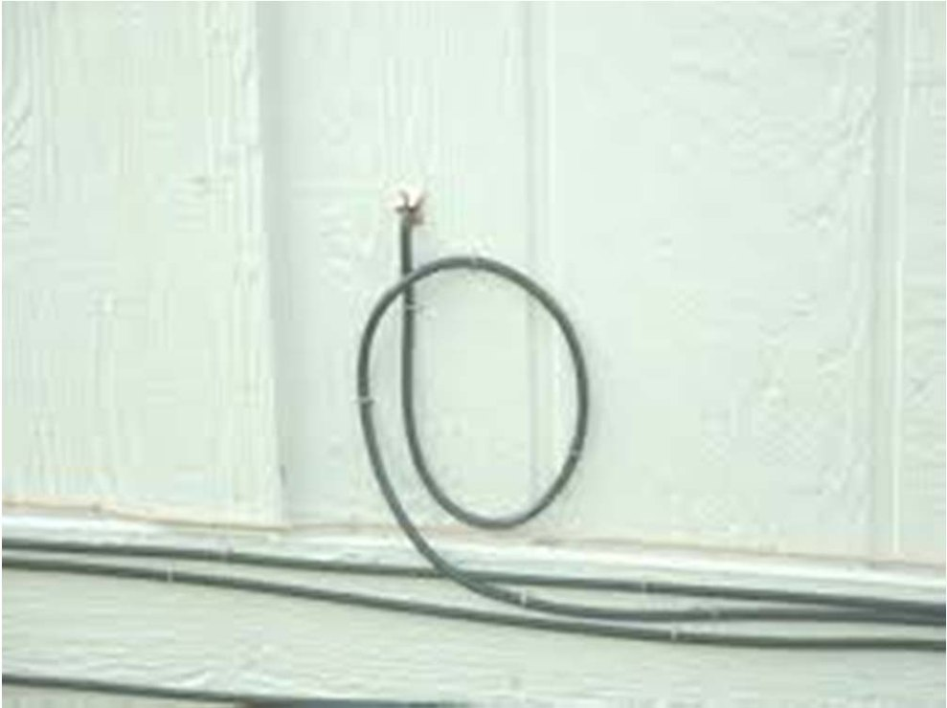
Service Loop, Drip Loop

Slide 31
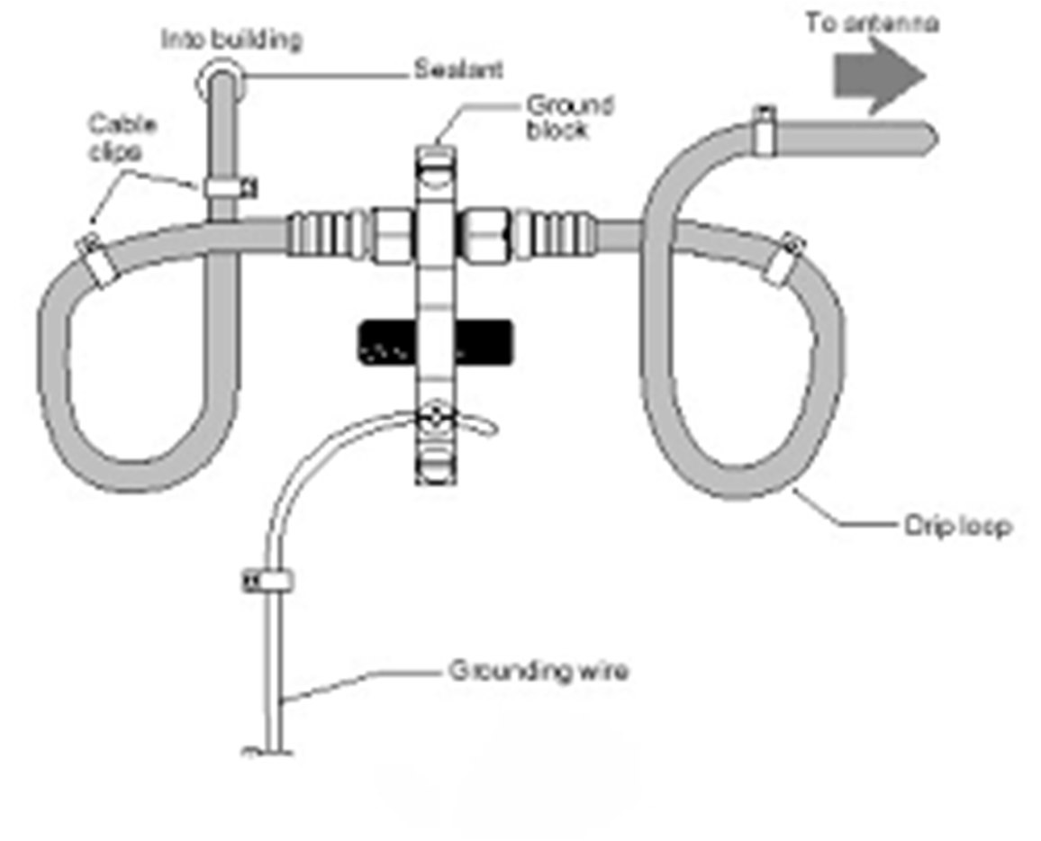
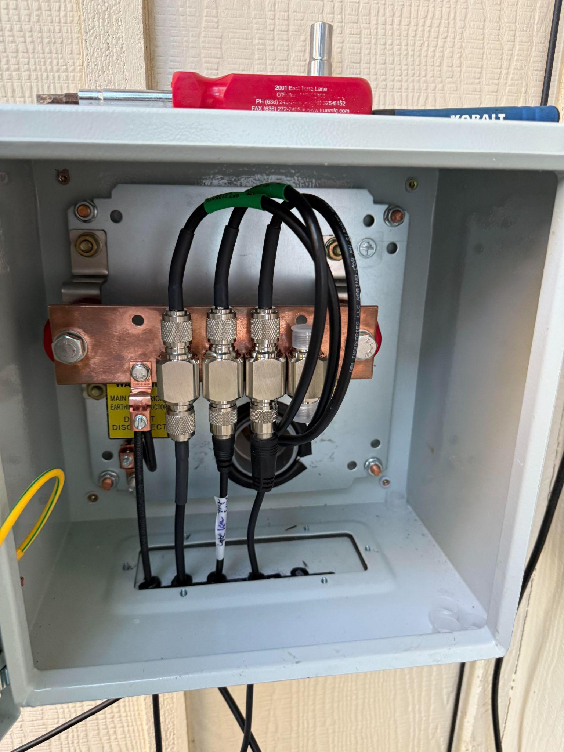
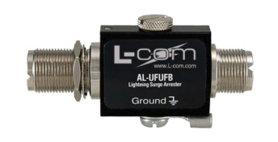
Grounding, lightning protection

Slide 32
Q & A
Over – to you

